Slide 1
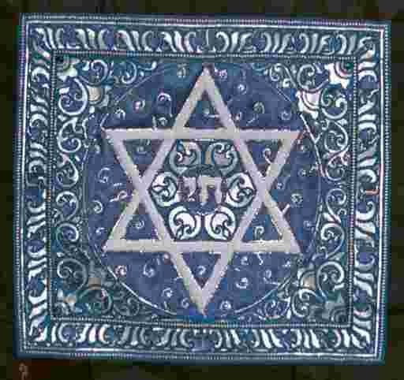
AQA
GCSE Religious Studies Judaism Practices: Workbook
Name:
1

Slide 2
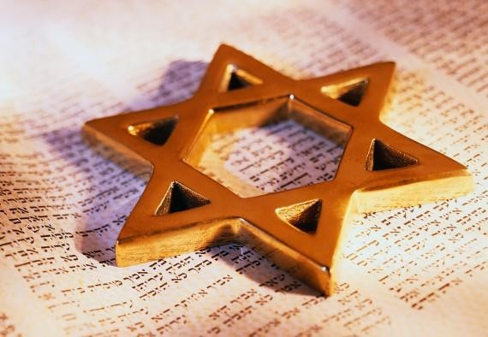
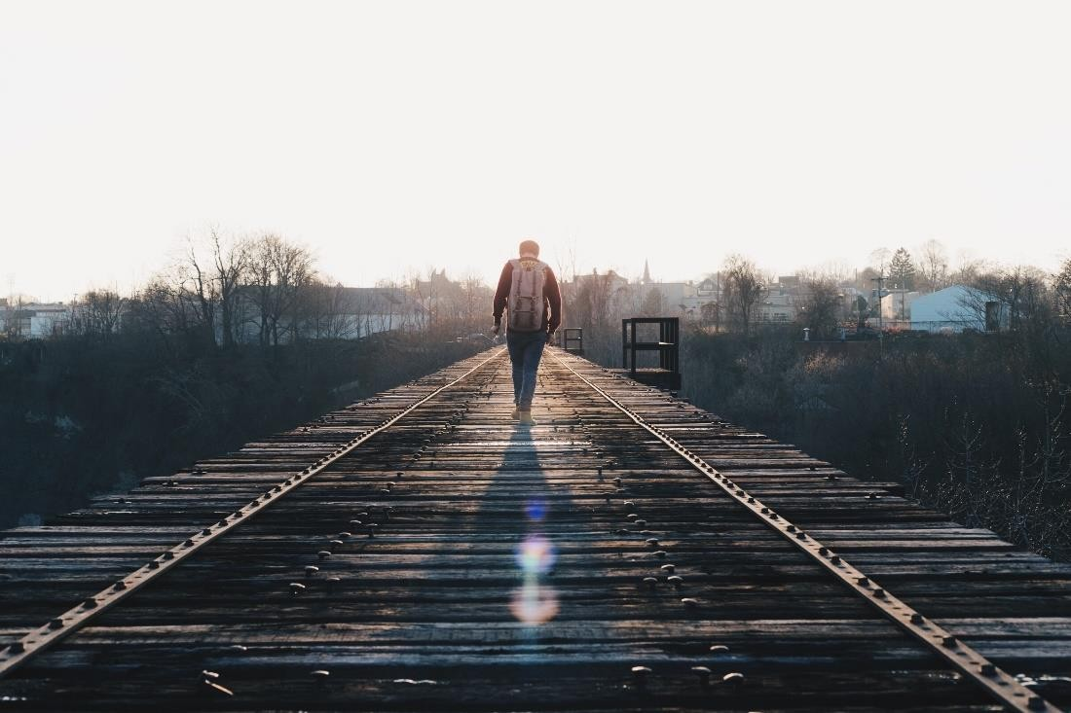
Practices
Judaism is not just a religion, it is a whole way of life. Over many centuries of persecution, Judaism has relied on family life for its continued existence and to flourish. Children learned through their families and the practices and traditions (minhagim) which were kept, and, at times this was the only way to follow the religion and keep it going. Much of this unit is about how religion and family life intertwine.
The halakha is Jewish Law. ‘Halakah’ is translated as ‘the path one walks’. In other words, halakha is the way Jews should live their lives. It covers every aspect of life and is quite comprehensive in giving guidance on behaviour. For example, it tells Jews about the food they can or cannot eat, the types of materials they can wear, the jobs they can do, how to keep themselves clean, how to worship, how to bring up a family, and much more. It is possible and correct to consult the halakha about everything in daily life.
Another way to look at it is to see halakha as giving a spiritual significance to everything done; everything becomes an act of worship, everything links back to faith, everything is a reminder of G-d and one’s relationship with G-d.

Slide 3
The Law in Judaism
Judaism governs all aspect of Jewish life. Most of the Jewish law can be found in the Tenakh. The Talmud is a written interpretation of the law.
The Tenakh
The Tenakh is the holy scripture of Judaism, as a whole. There are three parts: the Torah (Law), the Nevi’im (Prophets), and the Ketuvim (Writings). The word ‘Tenakh’ comes from the first letter in Hebrew of each of the three sections. The most sacred part of the Tenakh is the Torah. It is this which is written onto scrolls for use in the synagogue and is read as a whole each year there. This part is considered to be the word of G-d, written by Moses and a crucial link between G-d and humanity. It is here we find the mitzvot, the rules which make up Jewish law.
The Torah
The contents make up the religious law of Judaism. It is believed that this was told to Moses on Mount Sinai by G-d, so it is of divine origin, hence being considered the Word of G-d. Some Jews believe it existed before even the world existed, as part of
G-d’s divine law.
‘Torah’ means guidance or instruction. Following its rules means that the Jewish people stay close to G-d. These rules also separate Jews from other people in that they follow a specific path, which is true of any religion when fully followed. This is part of the 3rd covenant, which G-d made with Moses.
The Torah contains two types of law: mishpatim (judgements) – laws which are obvious to follow, such as ‘do not kill’, and chukim (statutes) – laws to be followed as a test of faith, such as the food laws.
The Torah is absolute, eternal and relevant everywhere, forever.
At synagogue on Monday, Thursday and Saturday a prescribed portion of the Torah is read. It is divided into 54 portions, and beginning on the festival of Simchat Torah, the final portion (from

Slide 4
Deuteronomy) and the first portion (from Genesis) are read in the synagogue. Over the year, the whole of the Torah is read from start to finish in order.
Study of the Torah is crucial and many (particularly Orthodox) Jews devote their lives to this study. In Israel, up to 60% of ultra-Orthodox Jewish men are in full-time, state-financed study of the Torah instead of working.
The Nevi’im
These are the books of the prophets; their stories and their teachings. Prophets are people chosen by G-d to guide humanity and make pronouncements for G-d; often warnings about behaviour. They provide a historical narrative of early Judaism, as well as religious interpretations of those events and revelations from G-d. They also try to show the character of G-d through these events.
Some people see the prophets as ‘G-d’s spokesmen on Earth’; a way to show that their main role was to obey G-d and deliver G-d’s message. This was not always their preference though. They story of Jonah is an example of that, he tried to avoid doing what G-d wanted him to, got swallowed by a whale and finally agreed to do as he was told.
The Ketuvim
These are a range of literature, from books of poetry (e.g. Psalms) to books of historical stories (.e.g. Daniel), to books of philosophical debate (e.g. Job).
Ketuvim means ‘writings’, and they are a collection of unconnected books. However, there is an underlying theme. Every book demonstrates a commitment to G-d which has been forged through difficulty and hard work.
Five books from the Ketuvim are also known as Megillot, and are used in specific festivals. These
are Song of Songs (Pesach). Ruth (Shavuot), Lamentations (Tishah B’Av), Ecclesiastes (Sukkot), and
Esther (Purim).
Tasks:
Explain the belief that Judaism is a ‘way of life’.
………………………………………………………………………………………………………………………...
………………………………………………………………………………………………………………………...
What is the Tenakh? What are its parts?
………………………………………………………………………………………………………………………...
………………………………………………………………………………………………………………………...

Slide 5
Explain the two different types of law in the Torah.
………………………………………………………………………………………………………………………...
………………………………………………………………………………………………………………………...
What is the purpose of the Nevi’im?
………………………………………………………………………………………………………………………...
………………………………………………………………………………………………………………………...
What is the purpose of the Ketuvim?
………………………………………………………………………………………………………………………...
………………………………………………………………………………………………………………………...
“The Torah is the only important part of the Tenakh.” Do you agree with this statement? Explain your opinion. Give an alternative view.
………………………………………………………………………………………………………………………...
………………………………………………………………………………………………………………………...
………………………………………………………………………………………………………………………...
………………………………………………………………………………………………………………………...
………………………………………………………………………………………………………………………...
………………………………………………………………………………………………………………………...
7. “Holy books are not relevant in life today.” Give reasons to agree and disagree with this
statement. Refer to the Tenakh in your answer.
………………………………………………………………………………………………………………………...
………………………………………………………………………………………………………………………...
………………………………………………………………………………………………………………………...
………………………………………………………………………………………………………………………...
………………………………………………………………………………………………………………………...
………………………………………………………………………………………………………………………...
………………………………………………………………………………………………………………………...

Slide 6
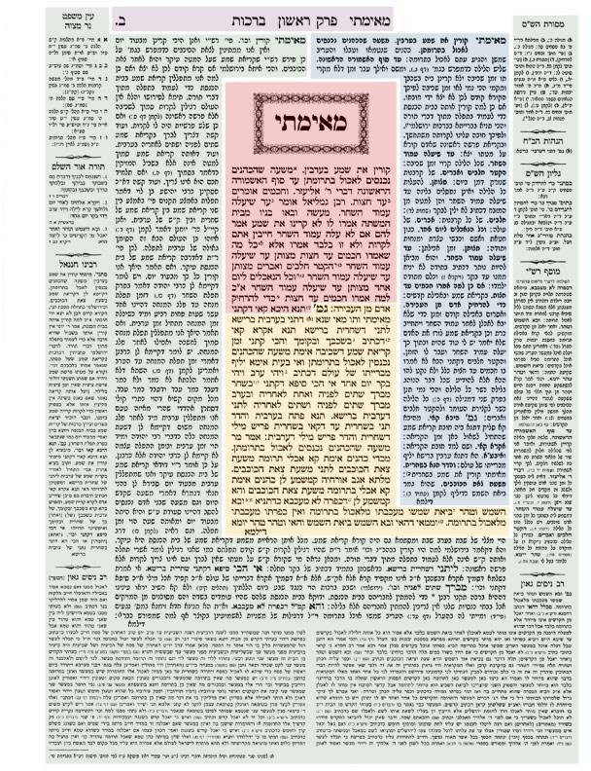
The Talmud
The Torah has laws for Jews to follow, but it was quickly realised that the laws did not give everyone an obvious answer to every question, and that life being as it is, it is difficult to apply the same law to every situation. Whilst the Torah is ‘timeless’, it still needs to be interpreted and applied if a person is to follow it correctly. The Talmud sets out to do this.
The Talmud is the entirety of Jewish civil and religious law, including commentaries on the Torah.
The Talmud
The central and key aspects are the Mishnah, which is a study of Jewish law. The Mishnah can be seen in the image in the middle, in red.
The Gemara is a commentary on the Mishnah, seen in yellow. Immediately around it are the references to the Torah and the Tenakh, so the reader can see where the origins of this Mishnah come from in their religion.
Rabbi Yehudah ha-Nasi (also known as Rabbi Judah the Prince, who lived in the second century CE) was responsible for
the most famous Mishnah, which splits the law into six categories and comment on each. These categories are: laws on agriculture and benedictions, festivals, women, civil law, sacred things, cleanliness.
The Gemara, meaning ‘completion’, is the completed discussion of the law. It is written beside the part of the Mishnah it relates to, and its aim is to discuss, explain and simplify the Mishnah.
Around the central text are two sections of commentaries. On its left, the Tosafot are commentaries which were written in the Middle Ages, and on its right is commentary by

Slide 7
Rabbi Solomon ben Isaac (Rashi) from the eleventh century CE. The bottom left and bottom right sections are more commentaries: by medieval Rabbis (on the left) and more recent ones (on the right).
In the outside left and right of the page, you can see references to Jewish law (left) and Talmud (right), so the reader is able to look up other laws which relate to the commentaries or are referenced in them. This helps their understanding.
‘The Talmud is really about the conversation, and the conversation never ends.’
Rabbi Dov Linzer
The line of text at the top is like a title line, telling you the page number, what you are reading about, etc.
Why is the Talmud important?
‘If the Tenakh is the cornerstone of Judaism, then the Talmud is the central pillar.’ Rabbi Adin Even Israel Steinsaltz
The Talmud is important because it helps a Jew to understand G- d’s law and so live a correct life. The laws are there, but not absolutely clear. They might tell you that you have to do
something, but not how to do it, for example: that meat has to be from a ritually slaughtered animal, but not what constitutes as ritual slaughter.
The Torah is part of the Covenant made with G-d and Moses and is how Jews can understand how to fulfil the Covenant. Time changes how people live and what people do, and even though the Torah is timeless, it does not mention many things, for example new technology. The commentaries apply today’s problems to Torah law.
It has been said that the Talmud has moulded the Jews as a nation. Many aspects of Jewish culture are connected to, or are based on, or are inspired by the Talmud.
Talmud means ‘study’. This is important because Jews don’t must memorise the Talmud, they study it. So study brings greater understanding of the Torah and so helping Jews to follow G-d’s commands more effectively.
The Midrash
The Midrash is a kind of literature written by Rabbis. It means ‘story telling’ and explores the ethics and values in texts from the Tenakh. There are two kinds – haggadah (story) and halakha. It is used to interpret the texts or answer questions which arise from them, questions which are not clearly answered from the text itself.

Slide 8
Tasks:
What is the Talmud and why does it exist?
………………………………………………………………………………………………………………………...
………………………………………………………………………………………………………………………...
What is the Midrash?
………………………………………………………………………………………………………………………...
………………………………………………………………………………………………………………………...
What is the Gemara and what does it mean?
………………………………………………………………………………………………………………………...
………………………………………………………………………………………………………………………...
What can be found on the outside left and right of the page?
………………………………………………………………………………………………………………………...
………………………………………………………………………………………………………………………...
Explain why the Talmud is important.
………………………………………………………………………………………………………………………...
………………………………………………………………………………………………………………………...
………………………………………………………………………………………………………………………...
………………………………………………………………………………………………………………………...
“Jews only need the Mishnah to understand how G-d wants them to live.” Do you agree
with this statement? Explain your opinion. Give an alternative view.
………………………………………………………………………………………………………………………...
………………………………………………………………………………………………………………………...
………………………………………………………………………………………………………………………...
………………………………………………………………………………………………………………………...
………………………………………………………………………………………………………………………...
………………………………………………………………………………………………………………………...
………………………………………………………………………………………………………………………...

Slide 9
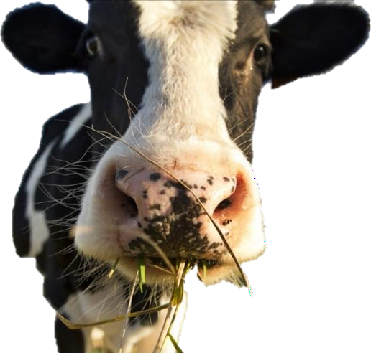
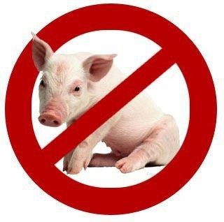

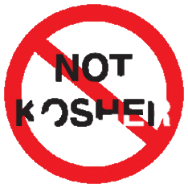
Jewish Dietary Law
Kashrut is the word that covers things that meet Jewish religious requirements. It is used mostly in describing the food laws and to indicate which foods are edible. The food laws are a good way to keep the Jewish people as a distinct group; G-d’s way of separating them from others as the ‘chosen people’.
Where do the rules come from?
The key sections of the Torah are Leviticus 11 and Deuteronomy 14, which explain the animals that can be eaten (kosher) and the animals which are ‘unclean’ and cannot be eaten (treyfah).
Deuteronomy 14: You shall not eat any abomination.
4These are the animals that you may eat: ox, lamb, and kid,
5gazelle, deer, and antelope, ibex, chamois, bison, and giraffe.
6And every animal that has a split hoof and has a hoof cloven into two hoof sections, [and] chews the cud among the animals that you may eat.
7But you shall not eat of those that chew the cud, or of those that have the split hooves: the cloven one, the camel, the hyrax, and the hare, for they chew the cud, but do not have split hooves; they are unclean for you.
8And the pig, because it has a split hoof, but does not chew the cud; it is unclean for you. You shall neither eat of their flesh nor touch their carcass.
9These you may eat of all that are in the waters; all that have fins and scales, you may eat.
10But whatever does not have fins and scales, you shall not eat; it is unclean for you.
11You may eat every clean bird.
12But these are those from which you shall not eat: The eagle [or the griffin vulture], the ossifrage, the osprey;

Slide 10
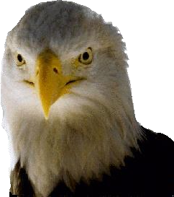
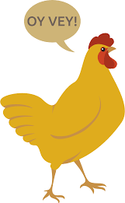
13and the white vulture, and the black vulture, and the kite after its species;
14And every raven after its species;
15And the ostrich, and the owl, and the gull, and the hawk after its species;
16The falcon, and the ibis, and the bat;
17And the pelican, and the magpie, and the cormorant;
18And the stork, and the heron and its species, and the hoopoe, and the atalef.
19And every flying insect is unclean for you; they may not be eaten.
20You may eat any clean fowl.
21You shall not eat any carcass. You may give it to the stranger who is in your cities, that he may eat it, or you may sell it to a foreigner; for you are a holy people to the Lord, your G-d. You shall not cook a kid in its mother's milk.
If the ‘kosher’ animals are not ritually slaughtered, their meat is unclean, making it not kosher. Also, there are parts of kosher animals that are not to be eaten, for example, the internal fat of cattle, lamb and goat, is considered in the same way that blood is (as the ‘seat of life’), to is treyfah. This used to be burnt as sacrifice in the temple. The meat must be clean of blood. The sciatic sinew (which runs from the spine down the leg) must have been removed.
All fruit, vegetables and pulses can be eaten, and with either meat or milk because they are neutral (parev). However, they should have been washed and checked for bugs and insect, which are not kosher.
Milk and milk products are fine to eat, but there are rules about combining these with
meat. Deuteronomy 14 (above) states: “You shall not cook a kid in its mother’s milk.”
Observing dietary laws is very deep-rooted in Judaism. Many Jews keep dietary law very carefully, others loosely, and some do not keep it at all. However, all are at least aware of it. This, perhaps beyond all other factors, has prevented the Jews from being assimilated to other nations and, considering the Jews have usually lives in non-Jewish countries throughout their history, it is to be respected that dietary laws train people to master their appetites, which is important when you think that food is a limited resource – especially meat!

Slide 11
Tasks:
What is ‘kashrut’?
………………………………………………………………………………………………………………………...
What is ‘kosher’?
………………………………………………………………………………………………………………………...
What is ‘treyfah’?
………………………………………………………………………………………………………………………...
Name four animals that can be eaten, if they are ritually slaughtered.
………………………………………………………………………………………………………………………...
………………………………………………………………………………………………………………………...
What is ‘parev’?
………………………………………………………………………………………………………………………...
Explain how the dietary laws have been important in Judaism.
………………………………………………………………………………………………………………………...
………………………………………………………………………………………………………………………...
………………………………………………………………………………………………………………………...
………………………………………………………………………………………………………………………...
“It is fine for Jews to eat non-kosher food is there is no kosher meat available.” Do you
agree with this statement? Explain your opinion. Give an alternative view.
………………………………………………………………………………………………………………………...
………………………………………………………………………………………………………………………...
………………………………………………………………………………………………………………………...
………………………………………………………………………………………………………………………...
………………………………………………………………………………………………………………………...
………………………………………………………………………………………………………………………...
………………………………………………………………………………………………………………………...

Slide 12
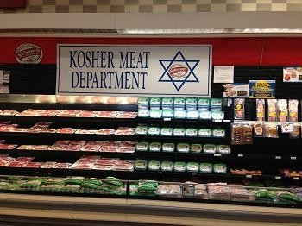
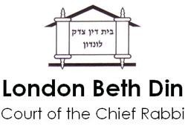
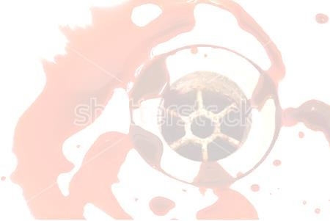
Dietary Law, contd.
Ritual Slaughter
Any meat that a Jews cooks and consumes must have come from an animal which:
Is allowed by scripture
Has been ritually slaughtered
The animal has to be slaughtered by a schochet (qualifies kosher slaughterer), through a quick,
deep stroke across the neck with a perfectly sharp blade. This leads to rapid blood loss and death. It is recognised as the most humane way to kill animals. A schochet is not only trained to be a butcher, he should be recognised as a
good man and should be well-trained in Jewish law.
Kosher butchers are regularly checked by the Bet Din (rabbinical court) to ensure they are observing kashrut at all times. They receive certification so that their customers can be sure of keeping the law.
Draining of Blood
The blood is the life of the animal (Leviticus 17:11) and is forbidden to Jews. So, the schochet will have removed most of the blood from the meat by the way they slaughtered the animal. The remaining blood is removed by one of three processes:
Broiling
Soaking
Salting
Each of these processes takes time. This has to be done within 72 hours of the slaughter. It is most common to buy meat that has already gone through the process.
12

Slide 13
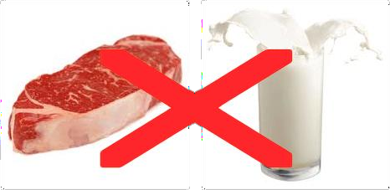
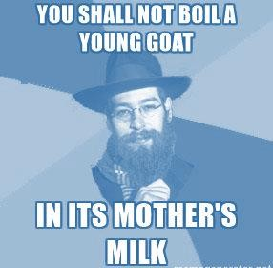
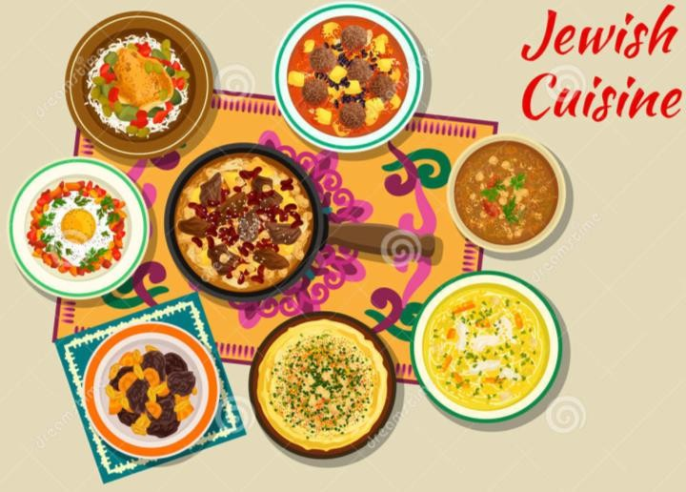
Meat and Milk
The Torah commands in three places to “not boil a kid in its mother’s milk,” which is explained by the Talmud to mean: no eating, no cooking, no benefiting from a mixture of meat and milk. For Jewish people this has meant not eating meat and milk products in
the same meal, or within six hours of each other (though this is reduced to three hours for meat after milk by many Jews).
Historically, we know that the Canaanite people (enemies of the Israelites in the early period of the religion) ate meat and milk in one of their rituals, so this may be why Jews were not allowed to – it clearly distinguished the Jews from other people.
There is also a sense of compassion. To have a mother seeing her child or vice versa being killed or cooked would be cruel. This assigns dignity and sanctity to the lives of both.
There are many non-milk replacement products now, which makes it easy to feed a mixed group of people the same meals. Many commercial businesses make good use of these products, for example, using ‘creamer’ in coffee, not milk.
Jewish Cuisine
There are lengthy traditions in Jewish cooking. Two distinct cultures exist in the food of Ashkenazi (Orthodox, North East European), based around stews, etc; and Sephardi (Spain and the Mediterranean) with its meze culture.

Slide 14
Tasks:
What are the two requirements for kosher meat?
………………………………………………………………………………………………………………………...
………………………………………………………………………………………………………………………...
Explain what is meant by ‘ritual slaughter’.
………………………………………………………………………………………………………………………...
………………………………………………………………………………………………………………………...
………………………………………………………………………………………………………………………...
………………………………………………………………………………………………………………………...
………………………………………………………………………………………………………………………...
………………………………………………………………………………………………………………………...
Why must kosher meat be drained of blood?
………………………………………………………………………………………………………………………...
………………………………………………………………………………………………………………………...
………………………………………………………………………………………………………………………...
Which three processes can remove blood from meat?
………………………………………………………………………………………………………………………...
………………………………………………………………………………………………………………………...
………………………………………………………………………………………………………………………...
Explain the rules about meat and milk.
………………………………………………………………………………………………………………………...
………………………………………………………………………………………………………………………...
………………………………………………………………………………………………………………………...
………………………………………………………………………………………………………………………...
………………………………………………………………………………………………………………………...
………………………………………………………………………………………………………………………...

Slide 15
Explain the argument from compassion regarding meat and milk.
………………………………………………………………………………………………………………………...
………………………………………………………………………………………………………………………...
………………………………………………………………………………………………………………………...
………………………………………………………………………………………………………………………...
………………………………………………………………………………………………………………………...
………………………………………………………………………………………………………………………...
“It is not difficult to keep a kosher diet in the UK today.” Do you agree with this statement?
Explain your opinion. Give an alternative view.
………………………………………………………………………………………………………………………...
………………………………………………………………………………………………………………………...
………………………………………………………………………………………………………………………...
………………………………………………………………………………………………………………………...
………………………………………………………………………………………………………………………...
………………………………………………………………………………………………………………………...
………………………………………………………………………………………………………………………...

Slide 16
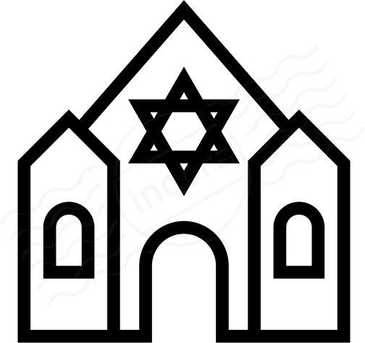
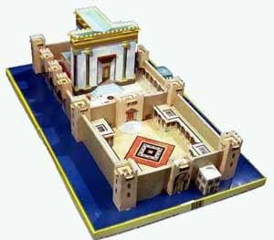
The Synagogue
History
The Synagogue is the place of worship for Judaism. It is a special place to worship G-d, It is also a place to study the Word of G-d and law, hence it is also known as ‘shul’ or ‘school’.
The idea of having a special place for worship goes back to the beginnings of Judaism. Moses received the instructions to build a special sanctuary (Tabernacle) in which sacrifices were to be made, and which housed the Ark of the Covenant, with the Ten
Commandments. Until the Jewish people had their own homeland, this sanctuary was mobile.
In the tenth century BCE, Solomon ruled a Jewish kingdom and the first major Temple was built in Jerusalem, within which was the ‘Holy of Holies’, housing the Ark. This Ark was lost in the sixth century BCE, when the Temple was destroyed. A new Temple was built in the fourth /fifth century BCE, which was finally destroyed by the Romans in 70CE. If you go to Jerusalem today, you can see the remnants of the Temple, which include the Western (or Wailing) Wall, which is an external extension of the Temple complex. Today, there is a mosque where the Temple used to stand. Throughout the time of the Temples, animal
sacrifices had been made there, with Jews being required to attend the Temple at three festivals during the year. Once the final destruction occurred, animal sacrifice ended with the
practice of having ‘high priests’. From this point, the rabbi became more important, until it was made a requirement that each synagogue should appoint such a person, as a preacher and scholar.

Slide 17
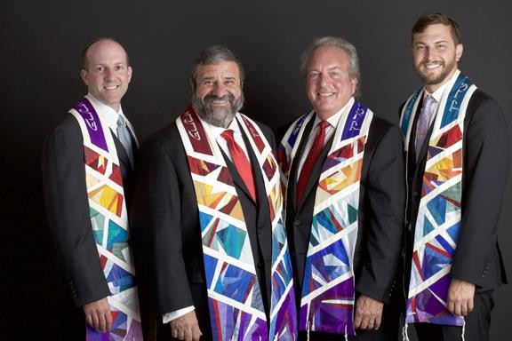
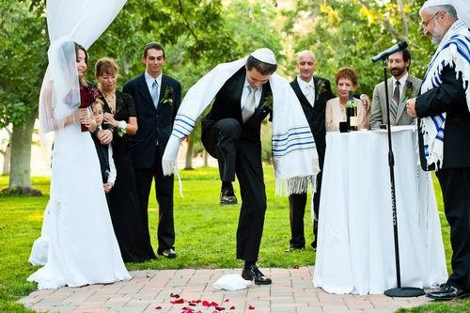
The first time synagogues are mentioned historically is in the sixth century BCE. Jews were exiled in Babylon (modern-day Iraq) and they could not go to the Temple. ‘Synagogue’ comes from a Greek word which means ‘bringing together’, showing that Jews came together. The synagogue was a place for study and prayer. The first archaeological evidence for synagogues dates from the third century BCE, with actual synagogues still existing in Palestine from the first century CE.
Why is the Synagogue important?
The Synagogue emphasises the idea of community as it brings together the whole congregation to worship G-d.
Also, it gave a space for the saying of specific prayers which require a minyan (ten men), for example, the Kaddish payer which is both a prayer that praises G-d and expresses a yearning for the
establishment of G-d’s kingdom on Earth. It is said at every service.
Importantly, the Synagogue is a house of worship – a Bet Tefilah.
Many Jews use the synagogue as a place of study (of scripture and law) for long periods.
Similarly, it is a place of teaching, where Jewish children can learn more about their religion and history. Its role in the community means that many synagogues also provide space for meetings, event and celebrations such as weddings.

Slide 18
Tasks:
Where does the idea of having a special place for worship come from?
………………………………………………………………………………………………………………………...
………………………………………………………………………………………………………………………...
What happened to the Temple in 70CE?
………………………………………………………………………………………………………………………...
………………………………………………………………………………………………………………………...
How did the ‘rabbi’ become important?
………………………………………………………………………………………………………………………...
………………………………………………………………………………………………………………………...
Why are synagogues important in Judaism?
………………………………………………………………………………………………………………………...
………………………………………………………………………………………………………………………...
………………………………………………………………………………………………………………………...
………………………………………………………………………………………………………………………...
………………………………………………………………………………………………………………………...
“The most important role of the synagogue is as a place of worship.” Do you agree with this
statement? Explain your opinion. Give an alternative view.
………………………………………………………………………………………………………………………...
………………………………………………………………………………………………………………………...
………………………………………………………………………………………………………………………...
………………………………………………………………………………………………………………………...
………………………………………………………………………………………………………………………...
………………………………………………………………………………………………………………………...
………………………………………………………………………………………………………………………...
………………………………………………………………………………………………………………………...
………………………………………………………………………………………………………………………...

Slide 19
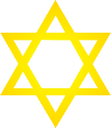
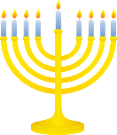
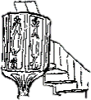
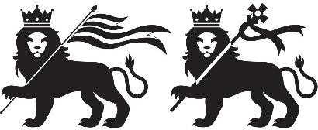
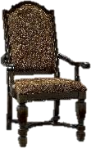
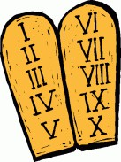
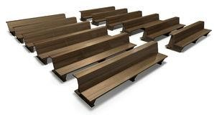
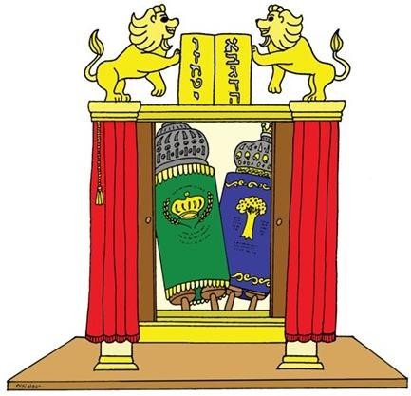
Key Features of a Synagogue
From the outside, many synagogues are quite plain. Often, the Star of David and/or a menorah mark it out as a synagogue.
Synagogues have many windows, often at a high level to let light in, and often with a stained glass to aid reflection and worship. They are usually rectangular and face towards Jerusalem.
There are a number of features that make the synagogue recognisable when you step inside. You would expect to see symbols such as the menorah, Star of David, Lions of Judah and the Ten Commandments.
Also, specific furniture, such as the pulpit for sermons in certain synagogues, the Rabbi’s seat and a woman’s gallery/section in Orthodox synagogues.
There are three important elements of the synagogue:
Aron Hakodesh
Ner Tamid
Bimah
Aron Hakodesh
This is also known as the Ark of the Covenant (Ark) and is found at the front-centre of a synagogue and is the most important part of the building. It houses at least one Torah scroll, which is used in services and is the most sacred object in Judaism. In the UK, it will be in the Eastern Wall, as when praying, Jews must face Jerusalem. It represents the Holy of Holies, which was the most sacred part of the Temple. In today’s synagogues, this is like a cupboard in the wall. It has a curtain over it (called a parokhet) to safeguard and glorify the contents. Traditionally, the Lions of Judah holding the Ten Commandments are painted above the Ark.
Ner Tamid

Slide 20
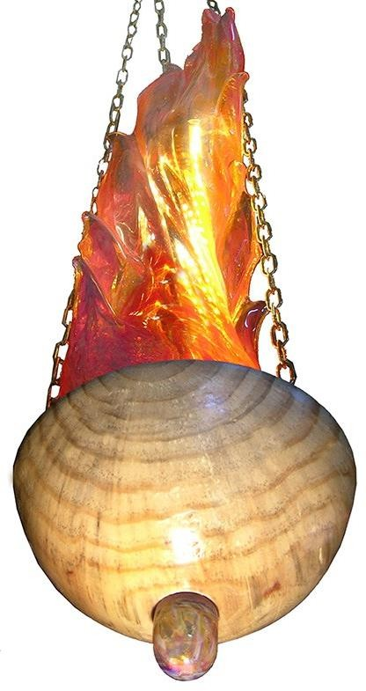
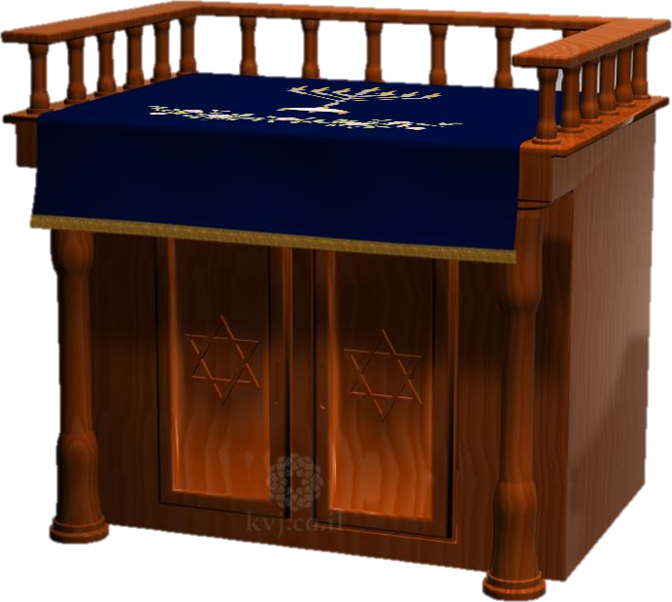
In the Tenakh, Jews were commanded to keep a lamp burning in the Tabernacle all the time. ‘Ner Tamid’ means ‘perpetual lamp’. It is always kept alight and represents the idea of the Torah having meaning and value always, and the merit of the Jewish faith (as if a light in the darkness of the world).
Traditionally it was an oil lamp, though in modern synagogues it is usually not (for convenience and safety), and it always hangs above the Aron Hakodesh.
Many see it as a symbol of Israel; destined to be the ‘light of nations’ in Isaiah 42:6, but also the idea that Israel should always exist as a nation.
Bimah
The Bimah is an elevated reading platform, from which the Sefer Torah is read during services. Traditionally, when the Sefer Torah was read, everyone would stand. In modern synagogues, the bimah is raised and represents the sanctuary in the Temple. Once the scrolls are in this holy place, in some synagogues, the congregation sit down (having been standing whilst it
was brought from the Ark). People physically look up to the Torah on the bimah, emphasising its importance and sanctity.
The bimah should be in the centre of the synagogue, symbolic in a number of ways:
When the Temple existed, an altar was in its centre, so too does the bimah
The Torah is read from the centre to show that its teachings should go out to the whole world
It recalls that the tabernacle was in the centre of the encampment when the Israelites were living in the desert
before reaching the Promised Land
Practically, having the Torah in the centre of the synagogue means that it is equally audible to everyone at the service

Slide 21
Tasks:
Which features mark a building as a synagogue? (Name four)
………………………………………………………………………………………………………………………...
………………………………………………………………………………………………………………………...
What is the Aron Hakodesh and why is it important?
………………………………………………………………………………………………………………………...
………………………………………………………………………………………………………………………...
What is the Ner Tamid and why is it important?
………………………………………………………………………………………………………………………...
………………………………………………………………………………………………………………………...
What is the Bimah and why is it important?
………………………………………………………………………………………………………………………...
………………………………………………………………………………………………………………………...
………………………………………………………………………………………………………………………...
………………………………………………………………………………………………………………………...
………………………………………………………………………………………………………………………...
“The Aron Hakodesh is the most important part of the synagogue.” Do you agree with this
statement? Explain your opinion. Give an alternative view.
………………………………………………………………………………………………………………………...
………………………………………………………………………………………………………………………...
………………………………………………………………………………………………………………………...
………………………………………………………………………………………………………………………...
………………………………………………………………………………………………………………………...
………………………………………………………………………………………………………………………...
………………………………………………………………………………………………………………………...
………………………………………………………………………………………………………………………...
………………………………………………………………………………………………………………………...

Slide 22
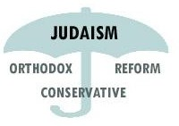
Synagogue Diversity
Apart from the physical differences between the synagogues from different Jewish denominations, the names used by Jews for their place of worship varies:
Orthodox and Hasidic Jews – ‘shul’ or ‘school’,
showing it to be an important place of study
Masorti Jews – ‘synagogue’, meaning ‘place of assembly’
Reform Jews – ‘temple’, to reflect its role as a
central place of worship
These terms give us an idea of the key role seen by different groups.
Key differences between Orthodox and Reform Synagogues
Men and women have separate sections in an Orthodox synagogue
In Reform, all face towards the Aron Hakodesh when seated, whereas in the Orthodox, they face the bimah
In Orthodox, the bimah is usually central to the room; in Reform, it will be a raised platform at the front, where Aron Hakodesh is
Orthodox refer to it as ‘shul’ (school); Reform refer to it as ‘temple’
If you visited twenty churches, you would see that none are exactly the same. The same is true for synagogues (and other religious buildings) – they are all at least a little bit different. Local and national culture also affect what they look like, but more importantly the strand or branch of the religion that the building belongs to has an impact on what it will look like.
“The synagogue is, most importantly, a place of study.” Do you agree with this statement? Explain
your opinion. Give an alternative view.
………………………………………………………………………………………………………………………...
………………………………………………………………………………………………………………………...
………………………………………………………………………………………………………………………...
………………………………………………………………………………………………………………………...
………………………………………………………………………………………………………………………...
………………………………………………………………………………………………………………………...
………………………………………………………………………………………………………………………...
………………………………………………………………………………………………………………………...

Slide 23


Public and Private Worship
Every aspect of Jewish life can be seen as an act of worship – devotion to G-d. Many acts of worship take place in the synagogue, however many also take place at home.
Daily Service
Study
Festivals
Prayers for the Sick
Worship in the Synagogue
Israel Dependence Day
Yarhzeit
Holocaust Memorial
Bar/Bat Mitzvah
Shabbat
Funeral
Marriage
Circumcision
Study
Festivals
Prayers for the Sick
Worship in the Home
Children's Prayer
Anniversaries
Shabbat
Dedication of Home
Havdalah
Mourning Period (Shiva)
Meals (thanksgiving)

Slide 24
As you can see from the diagrams, there are areas of overlap that reinforce the idea that the home and family are key to the Jewish faith.
Why is it important to worship?
It forms a part of the Covenant with Abraham, so is a duty
It shows devotion
It is a mitzvot; a law to keep
It keeps a person mindful of G-d’s presence throughout the day
It is an act of praise to G-d
It brings a community together
Jews can worship G-d at anytime and anywhere. A simple prayer might be said. They might take part in congregational worship (public) or they might devote time to religious study. They might dedicate any actions to G-d as an act of worship.
Tasks:
What is worship?
………………………………………………………………………………………………………………………...
………………………………………………………………………………………………………………………...
Which types of worship can be done in the synagogue that cannot be done at home?
………………………………………………………………………………………………………………………...
………………………………………………………………………………………………………………………...
Which types of worship can be done in at home that cannot be done in the synagogue?
………………………………………………………………………………………………………………………...
………………………………………………………………………………………………………………………...
Explain why worship is important to Jewish people.
………………………………………………………………………………………………………………………...
………………………………………………………………………………………………………………………...
………………………………………………………………………………………………………………………...
………………………………………………………………………………………………………………………...
………………………………………………………………………………………………………………………...
………………………………………………………………………………………………………………………...
………………………………………………………………………………………………………………………...

Slide 25
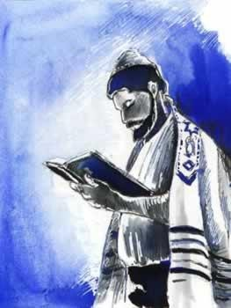
Worship in the Synagogue
Being dressed ready for worship
Jews wear a kippah, tallit and tefillin for prayer. Most of the men in an Orthodox act of worship will wear all three, though few in Reform synagogues will. All males will have their head covered, usually by a kippah.
However, it is crucial that people attending the synagogue dress well and they do not wear scruffy clothes. They should take care of their appearance.
This is simply a matter of respect.
Key People
The rabbi is the spiritual leader of a Jewish community. They may lead worship, though as it is scripted, others can also. This person (always male in Orthodox synagogues) must be of good character and will have studies Jewish law and teachings to a very high
level at a yeshivah (Torah school) and then rabbinical school. They are often aided by a cantor, who sings at points throughout the service, leading the congregation through prayer, particularly at Shabbat and festival services. There has to be a group of ten adults for an act of worship to take place, this is called a minyan.
The Structure of Worship
Worship is built around the reciting of different prayers. Two books are key: the siddur (or prayer book), which details the words and prayers which are said throughout a service, and the chamash, which is the Torah in printed form. Depending on which prayer-time in the day, the prayers said will vary. The key prayers are the Shema, the Amidah (18 blessings), the Kaddish and the Aleinu prayers. On Monday and Thursday, a portion of the Torah is read, whilst on Saturday, both the Torah and the Haftorah (Prophecies) are read.
There are differences between the different groups within Judaism. For example, the number of prayers and reading, and the exact choice of them all vary. Not every synagogue has its own rabbi or cantor – anyone can lead the service (as long as they are of good character and knowledgeable about faith).

Slide 26
Tasks:
What is the difference between Orthodox and Reform items worn in worship?
………………………………………………………………………………………………………………………...
………………………………………………………………………………………………………………………...
Who is the rabbi and who is the cantor?
………………………………………………………………………………………………………………………...
………………………………………………………………………………………………………………………...
What is a minyan?
………………………………………………………………………………………………………………………...
………………………………………………………………………………………………………………………...
Which two books are key to Jewish worship?
………………………………………………………………………………………………………………………...
………………………………………………………………………………………………………………………...
“Jews should dress well to attend synagogue.” Do you agree with this statement? Explain
your opinion. Give an alternative view.
………………………………………………………………………………………………………………………...
………………………………………………………………………………………………………………………...
………………………………………………………………………………………………………………………...
………………………………………………………………………………………………………………………...
………………………………………………………………………………………………………………………...
………………………………………………………………………………………………………………………...
………………………………………………………………………………………………………………………...
………………………………………………………………………………………………………………………...
………………………………………………………………………………………………………………………...

Slide 27

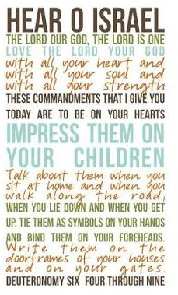
Prayer – The Shema
The Hebrew word for prayer is ‘tefillah’ and comes from a word that mean to judge oneself. This shows that, for Jews, prayer should be a time for reflection and thinking about how they are doing in their relationship with G-d, and in following their duties on Earth and not about begging G-d to change things.
There are many prayers, blessings and benedictions used in Judaism. In this guide, we will look at four – all of which are used in synagogue services. They are all found in the Siddur (prayer book), so it is not necessary to know them by heart. However, many Jews learn them. It is not just about the worlds, though. Judaism has many traditions (minhagim), and these along with the teaching of rabbis, have also shaped how the prayers are said and what is done whilst saying them.
The Shema
This is the declaration of faith. ‘Shema’ is the first word in Hebrew of this declaration, meaning ‘hear’ or ‘listen’. It must be recited three times daily in prayer, but it is a duty to recite it generally during the day as well. The Shema is taken directly from three paragraphs in the Torah: two from Deuteronomy and one from Numbers.
The way the Shema is said varies: Orthodox Jews see it as study, so remain seated; Reform Jews stand during the Shema as a form of respect.
All Jews say it aloud and clearly, because they are saying the basic beliefs of their faith. It is common to see Jews close/cover their eyes to focus completely on the words in the first verse of the Shema, as Jewish law demands this level of concentration. It is also common to see those wearing tallit holding the tzitzit (fringes) in their left hand whilst reciting the Shema. In its third paragraph, it mentions these three times, so it has become a custom to kiss the tzitzit as a sign of affection for the law, after the last word of the Shema has been said.

Slide 28
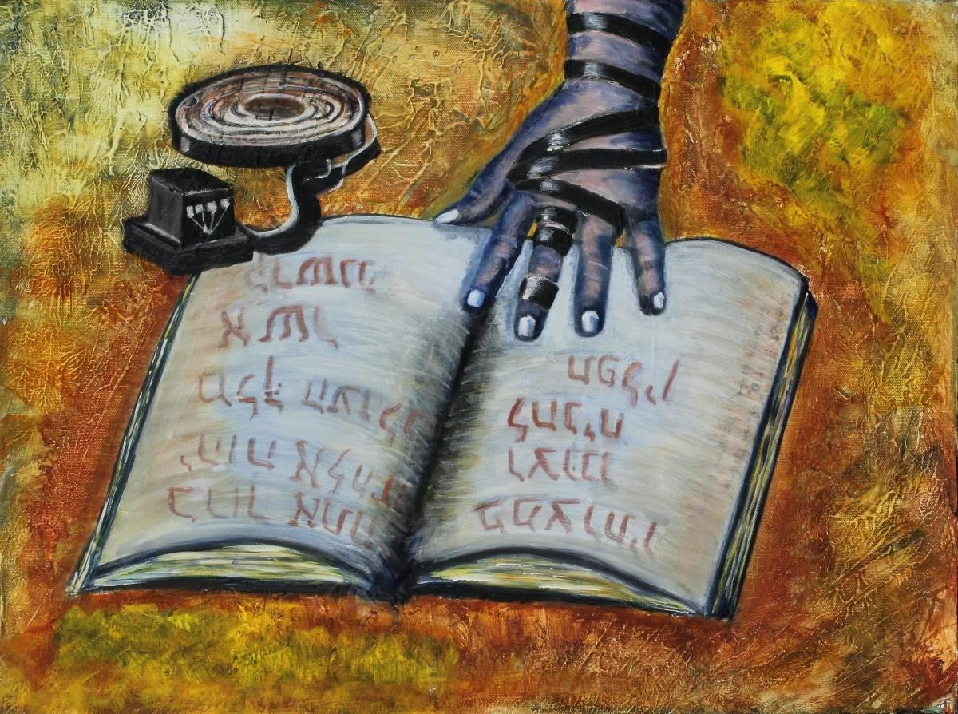
What does the Shema say?
It begins, ‘Hear, O Israel, the Lord is our G-d, the Lord is One G-d.’ This is a fundamental belief of Judaism, from which all other beliefs and the law flow. Then there is a sentence, ‘Blessed is the name of His Glorious Majesty forever and ever.’ This used to be said by the congregation in the temple in Jerusalem after the priests had said the first sentence. It is not actually from the Torah, so it is said quietly. Then there are three paragraphs, all from the Torah. These are about: G-d and religious duties to demonstrate love to G-d; about accepting the laws and the consequences of breaking or following them; about the mitzvot to wear tzitzit, mentioning the Exodus from Egypt.
Differences in Jewish Denominations
Reform Jews in the USA do not include all of the second two of these passages – they have a different idea about G-d’s retribution (what G-d will do if the mitzvot are not followed), and do not accept the mitzvot to wear tzitzit, so these parts are omitted from their Siddur. British Reform Jews, however, say them.

Slide 29
Tasks:
For Jews, what is prayer a time for?
………………………………………………………………………………………………………………………...
………………………………………………………………………………………………………………………...
Where can the prayers be found?
………………………………………………………………………………………………………………………...
………………………………………………………………………………………………………………………...
What is the ‘Shema’ prayer?
………………………………………………………………………………………………………………………...
………………………………………………………………………………………………………………………...
Explain how the Shema prayer is said.
………………………………………………………………………………………………………………………...
………………………………………………………………………………………………………………………...
………………………………………………………………………………………………………………………...
………………………………………………………………………………………………………………………...
………………………………………………………………………………………………………………………...
………………………………………………………………………………………………………………………...
………………………………………………………………………………………………………………………...
Explain what the Shema prayer says.
………………………………………………………………………………………………………………………...
………………………………………………………………………………………………………………………...
………………………………………………………………………………………………………………………...
………………………………………………………………………………………………………………………...
………………………………………………………………………………………………………………………...
………………………………………………………………………………………………………………………...
………………………………………………………………………………………………………………………...

Slide 30
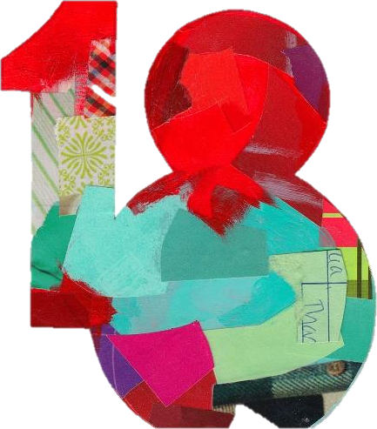
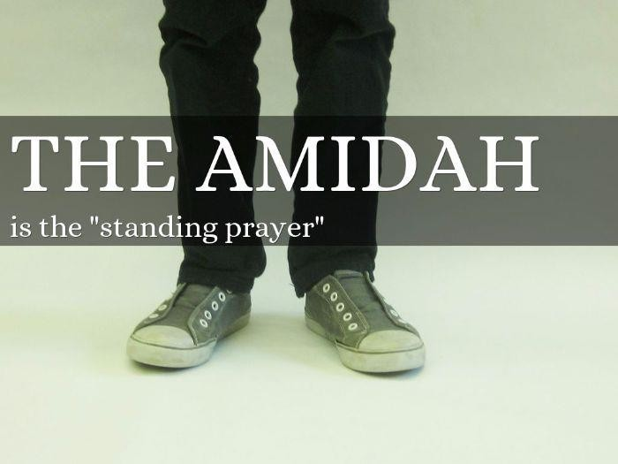
Prayer – The Amidah
The correct term for this prayer is the Shemonah Esreh or the 18 blessings. It is known as the Amidah because it is said whilst standing, and ‘Amidah’ means
‘standing’.
There are actually 19 blessing within the prayer now. Traditionally, a new blessing was added as significant things happened throughout history. By 5th Century BCE, 18 blessings were in place. The 19th was added in the 1st Century CE. The blessings take a specific and logical order, so they start with being clear on how important G-d is, far beyond humans, moving through limitations of being human, to the request to
accept prayers and the hope for peace. They can also be split into three groups: three blessings of praise, then 13 of requests and, finally, three of gratitude.
Most Jews follow the views of Maimonides (the man responsible for the Mishneh Torah) on how they say the Amidah) always standing, always facing Jerusalem). I Samuel 1:13 says that Hannah spoke to G-d merely by moving her lips – soundless – and so the Amidah is said in that way, as if the sound comes from the heart. During the prayer, rabbis have ruled Jews must bend their knee at the words Barukh, then bow at Attah, standing up straight at Adonai. This happens four times.
The Amidah is very sacred, as is the person’s space when saying it, so it is traditional to take three steps forward and back before beginning. At the end of the prayer, a Jew bows to the left, then to the right, and once again takes three steps backwards. Both actions represent approaching and leaving the presence of the King/Queen. They only return to their original place when the cantor begins his repetition of the Amidah. During this, the congregation will say ‘Amen’
after each blessing.
The Amidah is modified for special occasions, for example, on Shabbat or on a festival celebration, but will always keep the first and last three blessings the same. It is said during each of the three daily prayers. Once begun, it must be completed.

Slide 31
Tasks:
What is the Amidah prayer?
………………………………………………………………………………………………………………………...
………………………………………………………………………………………………………………………...
How many blessings are in the Amidah and how were they included?
………………………………………………………………………………………………………………………...
………………………………………………………………………………………………………………………...
Who was responsible for the Mishneh Torah?
………………………………………………………………………………………………………………………...
………………………………………………………………………………………………………………………...
Explain how the Amidah prayer is said/carried out.
………………………………………………………………………………………………………………………...
………………………………………………………………………………………………………………………...
………………………………………………………………………………………………………………………...
………………………………………………………………………………………………………………………...
………………………………………………………………………………………………………………………...
………………………………………………………………………………………………………………………...
Why do you think the Amidah must be finished, once started? Explain your opinion, showing an awareness of at least one other point of view.
………………………………………………………………………………………………………………………...
………………………………………………………………………………………………………………………...
………………………………………………………………………………………………………………………...
………………………………………………………………………………………………………………………...
………………………………………………………………………………………………………………………...
………………………………………………………………………………………………………………………...
………………………………………………………………………………………………………………………...

Slide 32
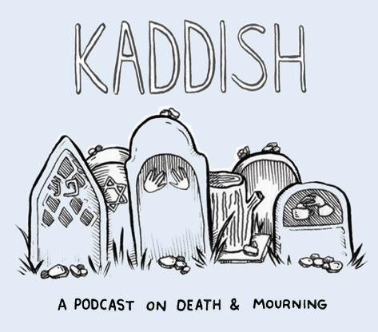
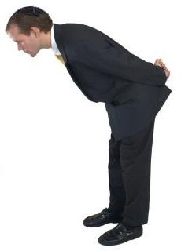
Prayer – The Kaddish
‘Kaddish’ means ‘holy’. It is a hymn of praises to G-d, beginning ‘May His great name be exalted…’ It can only be said if there is a minyan (ten men), as with the Amidah, so is recited at the synagogue each prayer time each day. It is in the Siddur.
There are different Kaddishes, the most commonly known
being the mourner’s Kaddish. A Midrashic text explains its value to the deceased, but Jewish scholars have also shown it is of value to the living. Essentially, the congregation are
praising G-d to remin d themselves that death and loss are part of a greater plan, so words of the Kaddish in praising G-d help mourners restore their own faith and attachment to G-d.
The Kaddish is recited aloud whilst standing. It is a call and response prayer, which means that one person says a phrase from the prayer and the congregation make a response.
Prayer – The Aleinu
The Aleinu is a closing prayer of a synagogue service, and actually combines two prayers. It is a prayer to praise G-d and restate a Jew’s dedication to G-d as one of the chosen people for whom there are many difficulties because of that choosing. It also reminds everyone that G-d’s rule is without end – eternal.
On ending the service, each person is reminded of G-d, His power and splendour; that all hope is in G-d and the wish to see G-d. They are making a commitment to G-d, dedicating themselves again to Him. As a mark of that commitment, many Jews will bow their knee towards the Aron Hakodesh, as if they are bowing to G-d.

Slide 33
Tasks:
What does ‘Kaddish’ mean?
………………………………………………………………………………………………………………………...
………………………………………………………………………………………………………………………...
Which is the most commonly known Kaddish?
………………………………………………………………………………………………………………………...
………………………………………………………………………………………………………………………...
How is the Kaddish recited?
………………………………………………………………………………………………………………………...
………………………………………………………………………………………………………………………...
What is a ‘call and response’ prayer?
………………………………………………………………………………………………………………………...
………………………………………………………………………………………………………………………...
What is the ‘Aleinu’ prayer?
………………………………………………………………………………………………………………………...
………………………………………………………………………………………………………………………...
Explain the importance of the Aleinu prayer.
………………………………………………………………………………………………………………………...
………………………………………………………………………………………………………………………...
………………………………………………………………………………………………………………………...
………………………………………………………………………………………………………………………...
………………………………………………………………………………………………………………………...
………………………………………………………………………………………………………………………...
………………………………………………………………………………………………………………………...

Slide 34
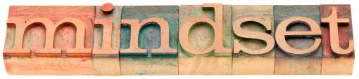
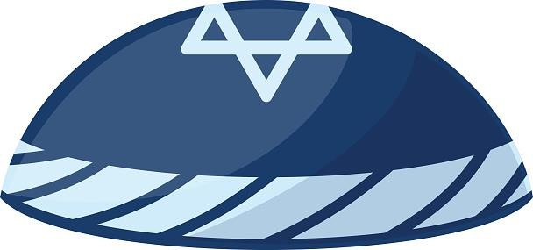
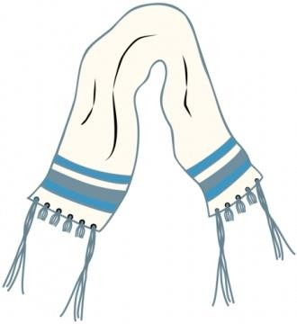
Prayer at Home
Not every Jew can get to the synagogues to pray for each of the required three prayer- times. Also, women do not attend synagogue except for on Shabbat. Therefore, private worship is common in Judaism. Since worship is based around prayer, it is a case of saying prayers which do not require a minyan (ten men). These are personal prayers, which require a person to be suitably prepared for prayer (both mentally and in appearance).
Kavanah is the mind-set for prayer. It is about having the right intention and focus. Just repeating the same prayers daily might lead a person to repeat them mindlessly and unthinkingly, so
people need to have the right mind-set. Additionally, a person should be clean and tidy for their prayer as a sign of respect for G-d and for what they are about to do.
Kippah
Also called a Yarmulke. This is a skullcap worn by Jewish men, though many woman also cover their heads, including with a form of kippah in the different traditions of Judaism. Covering the head is the Jewish way of showing respect, and to pray with the head uncovered would be breaking important rules of faith.
Tallit and Tzitzit
The tallit is a prayer shawl with four corners and a hole in each corner. However, once the tzitzit (fringes) are attached, it becomes a sacred item, fit for prayer. It is common for there to be blue in a prayer shawl, which represents G-d.
However, some Jews wear an all-white tallit,
showing atonement and forgiveness. Jews will wear the tallit across their shoulders and some over their heads when praying. It has to cover the body, hence the practice of very large shawls being used. This represents that the person wants to wrap themselves in G-d’s will. It is the custom of many denominations of Judaism that a man only begins to wear the tallit regularly after marriage; however, some Jews wear the tallit from their Bar Mitzvah.

Slide 35
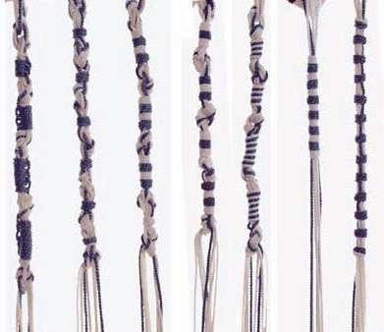
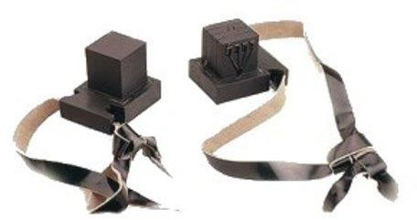
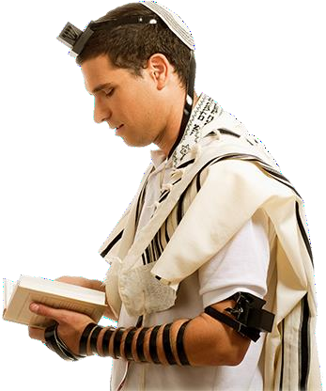
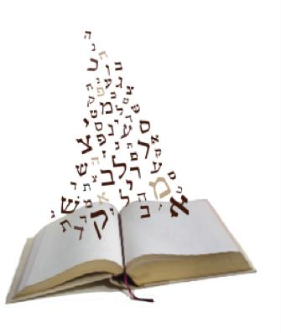
The tzitzit are the fringes which are affixed to each of the four corners of the tallit. They are twisted strands, tied and knotted, which hang loose. ~They represent the mitzvot, as well as the four corners of the Earth; the idea is that the commandments are relevant everywhere. Specific prayers, for example, when reciting the Keriat Shema (Shema in Hebrew), require the holding of tzitzit in the left hand opposite the heart to show love for G-d and the commandments and as a physical reminder of the commandments.
Tefillin
These are two small boxes with straps which are worn on the forehead and arm. Each contains parchment on which is written four passages from the Torah. They are on one strip for the arm and individual parchments for the head. These items are put on after the tallit.
When being put on, the tefillin help the wearer to focus their mind on the act of praying. Prayers are said at each stage as the items are put on. The arm tefillah points to the body, towards the heart, as a reminder of G-d’s love and of love for G-d and the commandments. The head tefillah symbolises constant awareness of G-d.
It is important for Jews to wear tefillin for prayer. The Talmud says many times that they must. The tefillin help a Jew to focus on their past history, present duties to keep the mitzvot and their future destiny. Having said that,
Shabbat does not require the wearing of tefillin because
the day already symbolises the Covenant with G-d.
Siddur
The Siddur is the prayer book with all the prayers and words to be read at any prayer time. It is the guide for the period of prayer to be carried out.

Slide 36
Tasks:
What is the kippah and what does it symbolise?
………………………………………………………………………………………………………………………...
………………………………………………………………………………………………………………………...
What is the tallit and what does it symbolise?
………………………………………………………………………………………………………………………...
………………………………………………………………………………………………………………………...
What are the tzitzit and what do they symbolise?
………………………………………………………………………………………………………………………...
………………………………………………………………………………………………………………………...
What are the tefillin and what do they symbolise?
………………………………………………………………………………………………………………………...
………………………………………………………………………………………………………………………...
6. “It isn’t necessary to dress for prayer.” Do you agree with this statement? Explain your opinion. Give an alternative view.
………………………………………………………………………………………………………………………...
………………………………………………………………………………………………………………………...
………………………………………………………………………………………………………………………...
………………………………………………………………………………………………………………………...
………………………………………………………………………………………………………………………...
………………………………………………………………………………………………………………………...
………………………………………………………………………………………………………………………...
………………………………………………………………………………………………………………………...
………………………………………………………………………………………………………………………...
………………………………………………………………………………………………………………………...
………………………………………………………………………………………………………………………...

Slide 37
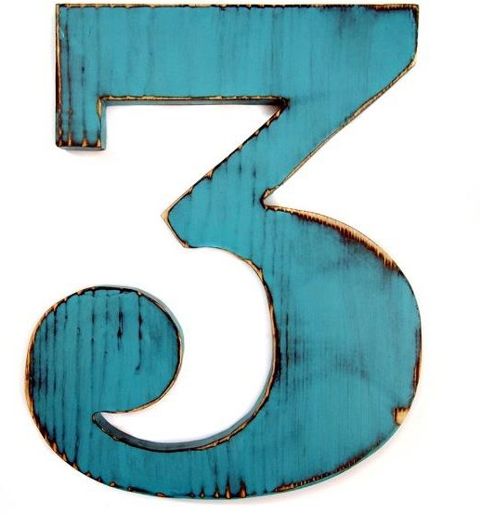

When to Pray
Jews pray three times every day. The first prayer is shacharit, in the morning. It recalls when sacrifices were made in the temple, and when Abraham chose to pray. He wanted to start his day with G-d, which then set him up to follow G-d’s commands.
The afternoon prayer is minchah, to reflect when afternoon sacrifice took place in the temple and follows Isaac’s timing for prayer. The pray to G-d at this time is to interrupt the day and remind oneself of G-d’s supreme importance.
The evening prayer is maariv, after Jacob’s practice. By praying in the evening, Jews can ensure that G-d is the last thing on their minds before going to sleep.
On Shabbat, High Holy Days and the new Moon, as additional prayer, musaf, is added, traditionally combines with the shacharit prayer. This parallels the extra sacrifice that was brought in the temple.
The importance of prayer
Jews pray because:
It is a mitzvot (commandment)
It shows devotion to G-d and a desire to be close to G-d
It allows them to do what is right
It allows them to get into the right frame of mind for prayer
It allows them to prepare for the day and reflect on the day
It is tradition: Jews have prayed since the start of the faith and many of the prayer come from historical times

Slide 38
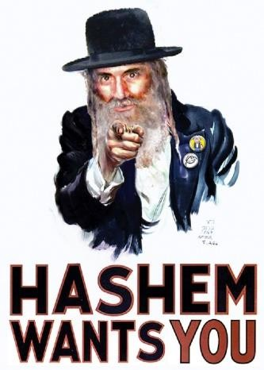
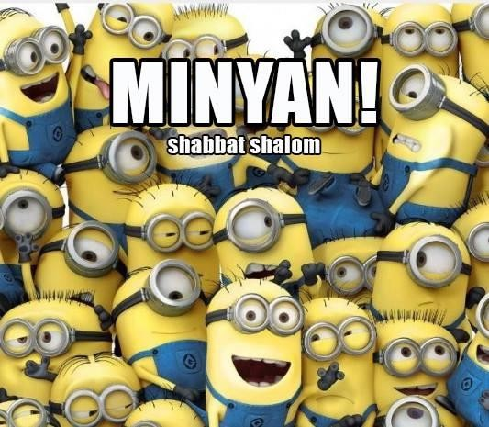
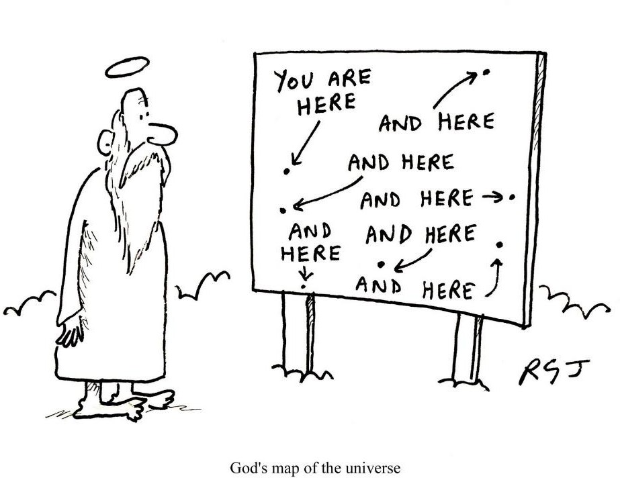
Prayers link Jews with the Jewish community – past, present and future
Prayer is a cleansing act, giving a sense of well-being and purification
It is communication with G-d
Prayer at home versus prayer in the synagogue
In Judaism, prayer is also about communicating with G-d, but also with other Jews. The rabbis said that congregational prayer was more important because the most important prayers (Amidah, Kaddish, Baruch Hu) all demand a minyan (ten men) for their recitation.
Maimonides said that G-d always answers the prayers of a community. Of course, it is also true that when people pray together in their place of worship, they can see the prayers being said and followed correctly, so they avoid mistakes, whereas when praying along, they could teach themselves incorrectly, and so offend G-d. Additionally, the language of the prayers is to say ‘us’ rather than ‘I’, which shows that a group should be saying the prayer, not the individual.
However, in many traditions of Judaism, women do not attend the synagogue other than for the Shabbat service, so they might have a much-reduced chance to pray in this way. Some might say this is not fair. Additionally, G-d sees everything and so it should be possible to pray anywhere at any time. This means it actually does not matter where
prayers are said, or how they are said, what matters is the sincerity of them.
G-d being everywhere is known as G-d’s
‘omnipresence’. The image
on the left, although comical, wouldn’t be acceptable in Judaism because no images or drawings of G-d are
permitted: “Do not make false images.”

Slide 39
Tasks:
Explain the reason behind several daily prayers.
………………………………………………………………………………………………………………………...
………………………………………………………………………………………………………………………...
………………………………………………………………………………………………………………………...
………………………………………………………………………………………………………………………...
Explain why prayer is important for Jews.
………………………………………………………………………………………………………………………...
………………………………………………………………………………………………………………………...
………………………………………………………………………………………………………………………...
………………………………………………………………………………………………………………………...
What is an advantage of praying in the synagogue, rather than at home?
………………………………………………………………………………………………………………………...
………………………………………………………………………………………………………………………...
What is an advantage of praying at home, rather than in the synagogue?
………………………………………………………………………………………………………………………...
………………………………………………………………………………………………………………………...
“All prayer should take place in the synagogue.” Do you agree with this statement? Explain
your opinion. Give an alternative view.
………………………………………………………………………………………………………………………...
………………………………………………………………………………………………………………………...
………………………………………………………………………………………………………………………...
………………………………………………………………………………………………………………………...
………………………………………………………………………………………………………………………...
………………………………………………………………………………………………………………………...
………………………………………………………………………………………………………………………...
………………………………………………………………………………………………………………………...

Slide 40
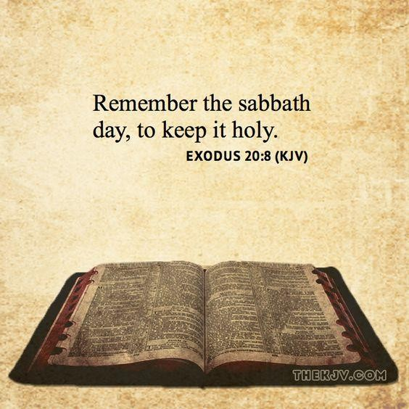
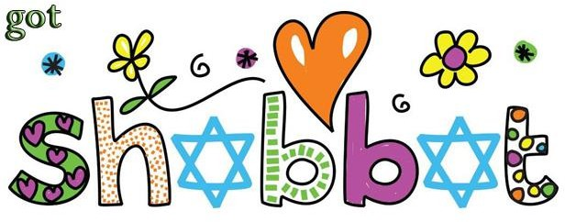
About Shabbat – Friday
Exodus 31: 16-17
“And the children of Israel shall keep the Sabbath to observe the Sabbath throughout the generations, for a perpetual covenant. It is a sign between Me and the Children of Israel forever, for six days the Lord made Heaven and Earth, and on the seventh say He ceased from work and rested.”
Deuteronomy 20:8
“Remember the Sabbath Day to keep it holy… for six days the Lord made Heaven and Earth, and rested on the seventh day.”
Exodus 20: 9-10
“Six days you shall labour and do all your work; but on the seventh day, which is a Sabbath in honour of the Lord your G-d, you shall not so any work, neither you, nor your son, nor your daughter, nor our male or female servant, nor your cattle, nor the stranger who is within your gates.”
About Shabbat
Shabbat is the Jewish day of rest, beginning at sundown on Friday and ending when the starts are out on Saturday evening. Jews keep Shabbat because they must – it is a commandment and part of their Covenant with G-d. It reminds them that G-d created the world and they are copying G-
d’s example of resting from important work. It is the only ritual mentioned in the Commandments:
Remember the Sabbath day, to
keep it holy. Families have passed on the traditions and laws of Shabbat to their children.
Not working on Shabbat
The Talmud forbids 39 areas of work on Shabbat. Many people think that ‘work’ can
mean anything you do, but ‘work’ only actually covers melachah tasks (creative tasks, or ones that exercise control over a person’s environment). This word is only used in the Torah in terms of Shabbat and building the Tabernacle, so the rabbis worked out the categories

Slide 41


of forbidden work from what was needed to build the Tabernacle. However, the principle of pikuach nefesh (to save a life) overrides Shabbat rules on work.
Getting ready for Shabbat
Shabbat is a sacred time, so a person cannot just go straight from the hassle of work into the peace of Shabbat. Most Jews shop for the Shabbat meals on Friday morning; meals taken on the day are light so as to make the evening meal taste even better.
Additionally, Jews have to prepare for Shabbat so that they avoid breaking the rules around work. Many things have to be prepared or put into place ahead of Shabbat. For example, any food has to be already prepared.
Shabbat begins
No later than 18 minutes before sunset, before the family meal begins, the woman of the house lights two Shabbat candles, passes her hands over her eyes and recites a blessing to welcome in Shabbat. The two candles represent sakhor (to remember Shabbat) and shamor (to observe Shabbat), which come from the two versions of the Ten Commandments in the Torah, which describe Shabbat. Whilst this should happen at a set time, (18 minutes) before Shabbat begins, in those communities living in a country where the starts are only visible very late, it might be done earlier. It must happen before Shabbat begins, as it is forbidden to make fire on the Sabbath.
The family attend the synagogue for the day’s evening service. In many Orthodox and Masorti families, just the men attend. Shabbat prayers are in two parts: Kabbalat Shabbat (six chapters from Psalms) and then Maariv prayers. During the second section the Amidah is reduced to just seven blessings by omitting the middle twelve (the petitions) to reflect the belief that all is provided on Shabbat. Instead, new paragraphs are inserted, reflecting the themes of Shabbat.
The family return to enjoy a leisurely mean. Before the meal, the man of the house blesses the children and then recites the Kiddush (a declaration that the day is holy and a prayer over the wine to sanctify Shabbat). This is followed by a blessing over two loaves of challah bread. During the meal, special songs are sung that reflect the themes of Shabbat. After the meal, another blessing is said, called birkat ha-mazon. This is said after any meal, but on Shabbat it can be said that the blessing is especially enjoyed.
The rest of the evening is free for family chat, but many choose to talk about their religion and the Torah. It is a time when families can share their religion.

Slide 42
Tasks:
Look at the quotes from Exodus and Deuteronomy. Why do Jews observe Shabbat?
………………………………………………………………………………………………………………………...
………………………………………………………………………………………………………………………...
………………………………………………………………………………………………………………………...
What does Shabbat remember?
………………………………………………………………………………………………………………………...
………………………………………………………………………………………………………………………...
What sort of ‘work’ is forbidden on Shabbat?
………………………………………………………………………………………………………………………...
………………………………………………………………………………………………………………………...
Explain how Jewish families prepare for Shabbat.
………………………………………………………………………………………………………………………...
………………………………………………………………………………………………………………………...
………………………………………………………………………………………………………………………...
………………………………………………………………………………………………………………………...
………………………………………………………………………………………………………………………...
“Attending the synagogue is an important part of Shabbat.” Do you agree with this
statement? Explain your opinion. Give an alternative view.
………………………………………………………………………………………………………………………...
………………………………………………………………………………………………………………………...
………………………………………………………………………………………………………………………...
………………………………………………………………………………………………………………………...
………………………………………………………………………………………………………………………...
………………………………………………………………………………………………………………………...
………………………………………………………………………………………………………………………...
………………………………………………………………………………………………………………………...

Slide 43


About Shabbat – Saturday
On Saturday morning, the rituals of Kiddush and the two challah are repeated. Whereas on Friday evening, Kiddush was to sanctify Shabbat, on Saturday morning it is just a mark of deference (respect) to Shabbat.
Shabbat services at the synagogue begin early and last for several hours and the whole family will attend.
The reading of the Torah is central to the Shabbat
service. The Torah scrolls will be taken from the Aron Hakodesh, processed around the synagogue, before being taken to the bimah to be read. The Torah scrolls are ‘dressed’ whilst not being read, so the coverings are removed before the scrolls are opened and read. The congregation will all stand until the scrolls are on the reading lectern on the bimah. Some will try to touch their tallit to the casing to show respect. The same portion of the Torah is read in every synagogue all over the world, and its message will be the focus of a sermon which is delivered by the rabbi. The Siddur (prayer book) is used to structure the service and is ensures that everyone says the right words. It is really important, as the service is long and difficult to follow from memory, especially when in Hebrew.
It is common for synagogue congregation to share Kiddush after the service; traditionally, wine and cake. This is, after all, a time when the community comes together to reinforce their sense of community and friendship.
Whilst many Orthodox Jews spend the afternoon studying the Torah at the synagogue, for many it is really a family time. It is a day of rest, so time is given to study of the Torah, Talmud and religion, but also to playing games or just resting/relaxing. Late afternoon is the time for a light meal – no one was allowed to work so the meal has to be ready to just put on the table, prepared before Shabbat begins.
Shabbat ends at sundown, when three stars are visible. The family perform a ritual to conclude Shabbat called Havdalah, which means separation, or division. This recognises the difference between the sacred time of Shabbat and the rest of the week. Blessings are recited over wine, spices and candles. The candles are special, having multiple wicks to represent torchlight. The spice box is full of aromatic spices and everyone takes a breath of the smell. Shabbat is so special, the knowledge of ending it saddens people, so the scent of the spice is uplifting.
Lighting candles is an act of work and it again indicated the end of Shabbat.

Slide 44
Tasks:
What is the difference between the Friday and Saturday Shabbat services?
………………………………………………………………………………………………………………………...
………………………………………………………………………………………………………………………...
Explain the Saturday Shabbat rituals.
………………………………………………………………………………………………………………………...
………………………………………………………………………………………………………………………...
………………………………………………………………………………………………………………………...
………………………………………………………………………………………………………………………...
………………………………………………………………………………………………………………………...
………………………………………………………………………………………………………………………...
………………………………………………………………………………………………………………………...
What will a synagogue congregation do after the Shabbat service? Why?
………………………………………………………………………………………………………………………...
………………………………………………………………………………………………………………………...
What will a family do once home from the Saturday Shabbat service?
………………………………………………………………………………………………………………………...
………………………………………………………………………………………………………………………...
Explain how a Jewish family separate themselves from Shabbat.
………………………………………………………………………………………………………………………...
………………………………………………………………………………………………………………………...
………………………………………………………………………………………………………………………...
………………………………………………………………………………………………………………………...
………………………………………………………………………………………………………………………...
………………………………………………………………………………………………………………………...
………………………………………………………………………………………………………………………...

Slide 45


The Importance, Influence and Diversity of Shabbat
Orthodox Jews
Walk to the synagogue as driving is considered work
Whole family goes to the Shabbat morning service
Women and men sit separately in the synagogue
After synagogue, the family return
home for a light meal
The males go to ‘shul’ (the
synagogue)
Females spend the day studying the Torah and Talmud at home
Final service at the synagogue is held
Final meal of Shabbat is shared at home
The family say ‘goodbye’ to Shabbat
Masorti Jews
Tradition in Judaism is very important. Jews have always celebrated Shabbat because of the Commandments, therefore they continue the tradition
Midrash tells Jews that Shabbat is a sample of the Messianic Age – how life could be, once the Messiah comes
Shabbat is a “queen” who is with Jews in their home for the whole of Shabbat
Reform Jews
Light candles before the evening meal, regardless of whether it is sundown or not (to not eat too late in Summer or too early in Winter)
Kiddush can be recited by any female in the house
May drive to the synagogue
Families (males and females) sit together to worship
During Shabbat, families might help others (tzedakah) or make cards to take to older relatives in care homes. This could be considered ‘work’ by Orthodox Jews as it is an act of creation
Shabbat is a time for relaxing, taking time out from the hectic world

Slide 46
Tasks:
Explain how different groups of Jews observe Shabbat.
………………………………………………………………………………………………………………………...
………………………………………………………………………………………………………………………...
………………………………………………………………………………………………………………………...
………………………………………………………………………………………………………………………...
………………………………………………………………………………………………………………………...
………………………………………………………………………………………………………………………...
What are the main differences between Orthodox and Reform observance of Shabbat?
………………………………………………………………………………………………………………………...
………………………………………………………………………………………………………………………...
………………………………………………………………………………………………………………………...
………………………………………………………………………………………………………………………...
………………………………………………………………………………………………………………………...
………………………………………………………………………………………………………………………...
“The commandment to observe Shabbat is the most important commandment.” Do you
agree with this statement? Explain your opinion. Give an alternative view.
………………………………………………………………………………………………………………………...
………………………………………………………………………………………………………………………...
………………………………………………………………………………………………………………………...
………………………………………………………………………………………………………………………...
………………………………………………………………………………………………………………………...
………………………………………………………………………………………………………………………...
………………………………………………………………………………………………………………………...
………………………………………………………………………………………………………………………...
………………………………………………………………………………………………………………………...
………………………………………………………………………………………………………………………...

Slide 47


Birth Ceremonies
In Judaism, the birth ceremony for boys is called Brit Milah. In Sephardic communities (where Jews are of Spanish, Middle Eastern or North African heritage) and Italian communities, there is also a tradition of welcoming girls with a celebration called ‘gift of the daughter’, or ‘zeved habat’.
The name of the ceremony comes from the book of Genesis, in which the matriarch Leah states, following the birth of Zevulun, “G-d grant me a gift.”
Brit Milah happens eight days after birth, unless there is ill health. The ceremony happens at home or in shul, as early as possible after Morning Prayer. A minyan should be present. A boy is circumcised as a mark of the Covenant between Abraham and the Israelites. It is seen as a commandment. It is also the rite through which a new-born male becomes part of the Jewish faith.
If the ceremony takes place in the home, a mohel (man trained to carry out circumcision) goes to the child. A kvater (G-dparent) takes the child from the mother to give to the father. He wears his tallit and tefillin, reminding him of the seriousness of this commandment he is following. He then gives the boy to a special, male guest (sandek) who will hold the child whilst the circumcision is carried out.
From the start of the ceremony, candles are lit by those present. It is said that when Moses was born, the room was lit up. So, lighting candles illuminates the room in the hope that the boy will group up to be a good Jew.
Then the mohel will bless the child as he carries out the circumcision. The father reads a blessing from the Siddur Torah. Finally, after completing the circumcision, the boy’s name is announced.
The baby is them given to its mother to be fed. It is traditional for there to be a celebratory meal.
For a girl, it is customary to name the new-born in the synagogue after the father has been called up to the Torah. This happens on the first Shabbat after her birth. In some communities, this happens on the first day after birth at which there is a Torah reading. In the Sephardi tradition, the congregation will sing songs to welcome her. It has become tradition for the parents to treat the congregation to Kiddush in celebration after the service. Reform Jews will take the baby girl to the Shabbat services, whereas in many other Jewish communities, she stays at home, where a rabbi will come to bless you.

Slide 48
Tasks:
Why are birth ceremonies important in Judaism?
………………………………………………………………………………………………………………………...
………………………………………………………………………………………………………………………...
………………………………………………………………………………………………………………………...
………………………………………………………………………………………………………………………...
Describe what happens during a Brit Milah ceremony.
………………………………………………………………………………………………………………………...
………………………………………………………………………………………………………………………...
………………………………………………………………………………………………………………………...
………………………………………………………………………………………………………………………...
Describe the baby naming ceremony for girls.
………………………………………………………………………………………………………………………...
………………………………………………………………………………………………………………………...
………………………………………………………………………………………………………………………...
………………………………………………………………………………………………………………………...
“New-born children should always be welcomes into a religion.” Do you agree with this
statement? Explain your opinion. Give an alternative view.
………………………………………………………………………………………………………………………...
………………………………………………………………………………………………………………………...
………………………………………………………………………………………………………………………...
………………………………………………………………………………………………………………………...
………………………………………………………………………………………………………………………...
………………………………………………………………………………………………………………………...
………………………………………………………………………………………………………………………...
………………………………………………………………………………………………………………………...
………………………………………………………………………………………………………………………...

Slide 49


Bar Mitzvah/Bat Mitzvah
Bar Mitzvah translates as ‘son of the commandments’. It is a recognition of the fact that a young man has reached the age by which he is personally responsible for his religious acts, and is marked by his first reading in the synagogue of the Torah.
From this point on, he is regarded as an adult in all religious aspects, for example, he should use tefillin in prayers and can count as one of the ten needed for a minyan. In fact, he remains Bar Mitzvah all of his life, it is not just for one day, as it refers to the duty of keeping the mitzvot, which is incumbent on all Jews. Males lead
the service in an Orthodox shul and so reading from the Torah is a way of showing the change in status from a child to an adult.
Girls have different roles within Jewish life and so they have different ceremonies. Girls reach the age of maturity at 12, so it is common to recognise that through the Bat Mitzvah ceremony. There is no special ceremony, and it is common, especially in the Orthodox community, to celebrate this at home, with the girl reciting a blessing and talking about the importance of the day. In the Reform and Liberal, and many of the conservative traditions, in recognition of changing societal norms and a sense of equality, there are special events in the synagogue. In the Reform and Liberal traditions, a girl may read the Torah at the synagogue, so the ceremony will be the same regardless of gender.
Why are these important?
It is the day when, religiously, the child becomes an adult
The child consciously steps into the responsibility of being one of G-d’s chosen
people
The child confirms their wish to keep the religion going
It is a central rite of passage to Judaism
Bar/Bat Mitzvah reinforces a person’s faith and enables them to understand it more
It promotes togetherness within the community
It binds the person to their community

Slide 50


Celebrating the occasion
Although the idea of Bar Mitzvah is in the Talmud, the custom of celebrating only began about six hundred years ago. It is common to give gifts to the young person and to have a family meal. Some families will pay for Kiddush at the synagogue for the congregation.
Some Jews believe that celebrations should be low-key, as there is no scriptural basis for over the top celebrations, like lavish parties. Certainly, a Bat Mitzvah celebration in the Orthodox community will be low-key. However it is becoming more and more common for Jews to go abroad to celebrate, wither to the Western Wall in Jerusalem, or to a place which is important in their family history.
The ceremony
Anyone undergoing the ceremony has to be prepares and be able to do well in the ceremony, so there is a period of preparation during which a religious person will instruct the young person in how to read and handle the Torah, as well as how to perform other religious obligations such as how to wear tefillin. It is quite common for young people to spend months studying the portion of the Torah they will read, and learning to wear the tefillin correctly.
For a boy, the ceremony takes place on the Shabbat after his 13th birthday as part of the usual service at the synagogue.
On the day of the Bar Mitzvah the Torah scroll is prepared on the bimah and then the rabbi calls the boy to read to the rest of the congregation. He goes up to the bimah and reads the passages in Hebrew for the Sabbath service. His father will then make a
particular blessing: ‘Blessed is he who has freed me from the liability of this one.” The Midrash states that a father is obligated to concern himself with the upbringing of his son until the age of thirteen, so when he becomes Bar Mitzvah, he is released from that duty. It is his natural father who must make the blessings, according to Jewish law. In some communities, the boy will read all of the Torah portions and will also lead the congregation in their prayers, which is a demonstration of them accepting him as an adult.

Slide 51


The rabbi then gives his sermon, part of this is for the boy to remind him of his duty to keep the commandments throughout his life. Finally, he is blessed by the rabbi with the words, ‘The
Lord bless thee and keep thee.’ Kiddush after the service allow s the congregation to celebrate this event, and there is often a big family celebration.
For Reform, Liberal and many Masorti Jews, the girl’s Bat Mitzvah would follow the same process in the synagogue, Some Masorti congregations do not allow girls to read the Torah and so will do the ceremony on the Friday evening, when the girl will recite the Prophetic reading which is to be read on the Saturday. Friday would not normally have readings.
For Orthodox Jews, the occasion is usually low-key, more of a private family affair, celebrated by a modest meal, blessings and new clothes.
However in some Orthodox communities, girls are now being allowed synagogue Bat Mitzvah, or allowed to address the congregation with a reading about their new religious status, which they would have written after doing their own research.
In the Reform tradition, it is not unusual to see a young person design part of their own Bar/Bat Mitzvah ceremony, including giving them sermons after research and study.

Slide 52
Tasks:
What is the difference between a Bar Mitzvah and a Bat Mitzvah?
………………………………………………………………………………………………………………………...
………………………………………………………………………………………………………………………...
Why are these ceremonies important in Judaism?
………………………………………………………………………………………………………………………...
………………………………………………………………………………………………………………………...
Describe the ceremony for a Bar Mitzvah.
………………………………………………………………………………………………………………………...
………………………………………………………………………………………………………………………...
………………………………………………………………………………………………………………………...
………………………………………………………………………………………………………………………...
Describe the celebrations for a Bat Mitzvah.
………………………………………………………………………………………………………………………...
………………………………………………………………………………………………………………………...
………………………………………………………………………………………………………………………...
………………………………………………………………………………………………………………………...
“Bar Mitzvah is more of a celebration than a serious religious event.” Do you agree with this
statement? Explain your opinion. Give an alternative view.
………………………………………………………………………………………………………………………...
………………………………………………………………………………………………………………………...
………………………………………………………………………………………………………………………...
………………………………………………………………………………………………………………………...
………………………………………………………………………………………………………………………...
………………………………………………………………………………………………………………………...
………………………………………………………………………………………………………………………...
………………………………………………………………………………………………………………………...

Slide 53


Marriage
This ceremony is full of custom and tradition. Marriage is a fulfilment of the commandment in Genesis 1:28: “Be fruitful and multiply.” In Judaism, having children was only rightly done within marriage; hence marriage being necessary to fulfil one of the earliest commands given to humans. However, it is not just about having children. It is seen as the natural state of things to be married. From the time of Adam, Eve was created as a helper and a companion for him, and so giving a template for living. It is seen as a blessing as it helps to overcome loneliness; both actual and spiritual loneliness. The idea is that the two partners complete each other; that marriage is a natural state and a blessing from G-d.
The Ceremony
In Talmudic times (70BCE to 500CE), there was a betrothal ceremony called a kiddushin and a separate marriage ceremony. These are now done either side of the reading of the ketubah (marriage contract).
The betrothal ceremony begins with the veiled bride approaching and circling her husband to be. Two blessings are recited over
wine; a blessing over wine, and one about the commandments of marriage. The man will then place the ring on his bride-to-be’s finger. The ring (or rings in Reform Judaism) must be an undecorated, unbroken circle, showing the hope for a harmonious marriage. The husband will recite from the Talmud: ‘With this ring, you are wedded to me in accordance with the laws of Moses and Israel.’ It is put on the forefinger of her right hand, and she then puts it on the ring finger on her left. This usually happens under the huppah (wedding canopy).
Next, the ketubah is signed in front of witnesses. It details the legal terms of the marriage; what is payable to her if the husband dies, or they divorce. It can be read aloud so that it is witnessed.
The bride walks around the groom (three times in some traditions, seven in others). This is a custom which links to Jeremiah 31:21, where it says a woman encompasses and protects her husband, and also Hosea 2:21-22, where G-d speaks to his people, saying

Slide 54


‘I betroth you’ three times. The huppah represents the marriage bedroom. Traditionally, weddings happen in the open air because of the blessing to Abraham that his children would be as numerous as the stars.
The rabbi might make a speech about the responsibilities of the marriage and about the couple. The cantor may sing. Seven blessings are said for the couple in the presence of the minyan, the fifth and sixth of which are specifically about marriage.
The bride and groom share a glass of wine and more blessings may be bestowed by the rabbi.
Finally the groom crushes a glass under his foot to remember the destruction of the Temple in Jerusalem. The act of breaking the glass also remind the couple that in times of joy, they must remain aware that there can be sadness and trouble, and to remain mindful helps them to manage those difficult times.
In most traditions, they go to a private room for about five minutes, this is called ‘Yichud’
(privacy). This is because before they are married hey cannot be alone together, so
being alone shows they are married. Today, it also gives them a moment’s peace in an
otherwise hectic day. With this act, the marriage is complete.
Some different traditions
Before the ceremony: most Jews fast before the ceremony, and most do not allow the couple to see each other on the day of the ceremony. In the Orthodox tradition it is common for the couple to not see each other the whole week before.

Slide 55




Aufruf: on Shabbat morning before the wedding, it is traditional in Orthodox Judaism for the groom to attend synagogue, be called up to read the Torah and receive the congratulations of the congregation. In many communities, he will be showered with nuts, almonds and raisins, or more commonly today, sweets. These symbolise that the bridegroom’s sins are forgiven and all will be ‘sweet’ or good.
Kabbalat Panim: Jewish Orthodox weddings start with a reception – separate for men and women. The groom greets his guests, who sing for him and toast his happiness and health. The bride sits on a throne to greet her guests. The mothers-in-law will break some pottery to show that marriage is a serious undertaking, and just as a broken plate cannot be properly repaired, neither can a broken marriage – so they must work at it.
Veiling the bride: in the Askhenazi tradition, the groom will go to the bride and put a veil over her face, which she wears until they leave the huppah. It means he has seen who he is marrying and is sure who is under the veil. This has Biblical origins as Rebecca covered her face before marrying Isaac. Or alternatively, recalls that Jacob was tricked into marrying Leah when he
should have been marrying Rachel, but her father had veiled her for the wedding and Jacob only saw her face once married. In some Masorti and Reform
synagogues now, the bride reciprocates by putting a kippah on the groom’s head,
or cloaking hi m in a tallit.
Circling the huppah: in Orthodox traditions, it is done seven times to represent the seven days of creation. In some traditions, just three.

Slide 56
Tasks:
Why is marriage important in Judaism?
………………………………………………………………………………………………………………………...
………………………………………………………………………………………………………………………...
Using the following words, describe the marriage ceremony: kiddushin; ketubah; rings; huppah; wine
………………………………………………………………………………………………………………………...
………………………………………………………………………………………………………………………...
Describe the wedding customs associated with different Jewish traditions.
………………………………………………………………………………………………………………………...
………………………………………………………………………………………………………………………...
………………………………………………………………………………………………………………………...
………………………………………………………………………………………………………………………...
Describe the symbolism in a Jewish wedding ceremony.
………………………………………………………………………………………………………………………...
………………………………………………………………………………………………………………………...
………………………………………………………………………………………………………………………...
………………………………………………………………………………………………………………………...
“Marriage ceremonies should not be dictated by tradition.” Do you agree with this
statement? Explain your opinion. Give an alternative view.
………………………………………………………………………………………………………………………...
………………………………………………………………………………………………………………………...
………………………………………………………………………………………………………………………...
………………………………………………………………………………………………………………………...
………………………………………………………………………………………………………………………...
………………………………………………………………………………………………………………………...
………………………………………………………………………………………………………………………...

Slide 57


Death and the Funeral
When a person dies:
The deceased is entitled to almost the same level of respect and dignity as a living person. At death, the eyes of the deceased must be closed, if not already. Some believe that a person cannot look on to this life and the life to come at the same time, so by closing the eyes, we close off this life and allow them to see the next. There is also scriptural authority to do this. The body
will be covered, because a dead body is unbecoming, and people should remember the deceased as when they were alive rather than dead. The body is put on the ground because it is a source of defilement, and anything it touches (or that touches it) becomes impure – except the ground. Candles are lit and places at the head, recognising Proverbs 6:23: “For the commandment is a lamp and the law a light.”
The corpse will be continually watched until burial to ensure the proper treatment, and because it is believed that the soul will only leave at this point. So it is reasonable to think that the soul would be in distress at the death, and someone witting with it is a comfort. They will recite Psalms constantly.
Each community has a Hevrah Kadishah (Holy Society) whose members are dedicated to preparing the body for and burying the dead. They will work with the funeral parlour to wash the body, dress it in white linen shrouds (showing all are equal in death). For male deceased, they are wrapped in their tallit, less one of its tzitzit, so that it is not a holy article, and that they no longer have to fulfil the commandments.
The act of washing is done according to Jewish law and has both physical and spiritual elements. The work of Hevrah Kadishah can be said to represent the last link in a chain of care and concern for the dead.
The Hevrah Kadishah keep the mitzvot of tahara. Tahara is ‘purification’ and is the
term used to prepare the deceased for their final resting place

Slide 58

Being part of the Hevrah Kadishah is all about teamwork. They are carrying out a sacred task. We act in the spirit of chesed (kindness).
The work of the Hevrah Kadhishah is so important. It is such a kindness – and the dead cannot reward this kindness.
The burial
Jews are always buried (not cremated). Genesis 3:19 says, “man is formed from dust, and returns to it.” The burial happens as soon after the death as possible, preferably on the same day. However, burials may not happen on Shabbat or on festival days. The casket must be made of wood.
A service may be held in the chapel of rest or at the graveside, following a similar process for either.
Kari’ah: the ritual of rending garments is observed. Different communities do this at different stages. The Orthodox do it straight after death, others before the funeral procession or at the burial. Mourners’ clothes are torn deliberately through the material (not along a seam) to represent emotional need and sadness. This copies scriptural practice. Many non-Orthodox Jews no longer tear clothes, but rather wear a strip of black ribbon on their outer garment. In the Reform tradition, this is given to them at the funeral.
The casket is carried to the grave, with seven stops made along the way. This shows how difficult the task is and also that there is no desire to hurriedly complete it.
The casket is lowered into the grave, with the head facing east, as it is believed that the dead will resurrect to rise facing east (to Jerusalem). Either during or just after this, prayers will be recited.
El Malei Rachamim (prayer of mercy) is recited at the graveside, or sung by the
cantor, followed by the mourner’s Kaddish, by the family.
It is customary for those attending to help fill the grave. A shovel is used, which each person puts down on the ground when they have used it, symbolising that
they do not want to pass sorrow to the next person. Others throw soil onto the casket. This ritual shows service and love.
The men in attendance make two lines between which the bereaved pass. The lines will murmur blessings on the bereaved: “May G-d console you among the other mourners of Zion and Jerusalem.”
On returning from the funeral, the first meal must be brought by neighbours and friends. It traditionally is a dairy-based meal (no meat) and it is customary for it to include egg (new life) and bread (staff of life). Many of the meals consumed by the bereaved during the next seven days will be brought to them as gifts of comfort by members of the community, which is part of the love and care given to mourners.

Slide 59
Tasks:
Explain the work of the Hevrah Kadishah.
………………………………………………………………………………………………………………………...
………………………………………………………………………………………………………………………...
………………………………………………………………………………………………………………………...
………………………………………………………………………………………………………………………...
………………………………………………………………………………………………………………………...
………………………………………………………………………………………………………………………...
………………………………………………………………………………………………………………………...
Describe in detail the funeral service, explaining the symbolism within it.
………………………………………………………………………………………………………………………...
………………………………………………………………………………………………………………………...
………………………………………………………………………………………………………………………...
………………………………………………………………………………………………………………………...
………………………………………………………………………………………………………………………...
………………………………………………………………………………………………………………………...
………………………………………………………………………………………………………………………...
“Funeral ceremonies benefit the living, not the dead.” Do you agree with this statement?
Explain your opinion. Give an alternative view.
………………………………………………………………………………………………………………………...
………………………………………………………………………………………………………………………...
………………………………………………………………………………………………………………………...
………………………………………………………………………………………………………………………...
………………………………………………………………………………………………………………………...
………………………………………………………………………………………………………………………...
………………………………………………………………………………………………………………………...
………………………………………………………………………………………………………………………...

Slide 60



Mourning
Judaism tried to control the mourning period and shape it so as to help the bereaved face reality of having to move on. There are four parts to the period of mourning.
Aninut: the period between death and the burial. During this period, the bereaved is excused from any and all commandments, even reciting Shema. They may not wear tefillin, cannot eat/drink at a festive table, cut their hair, wash their clothes, bathe themselves or have sexual relations.
Shiv’ah: meaning ‘seven’ is the seven days from closing the grave. Only bereaved parents, siblings, children or spouses observe this period and the remaining two. It is often known as ‘sitting Shiv’ah’ because of the practice of sitting on a low stool and not working. The prohibitions of Aninut remain in place, plus they may not greet people, study the Torah (other than laws of mourning, or tracts about suffering, for example, the book of Job), or sit in chairs. All the mirrors in the house are covered and a candle is lit which will last for seven days. Some rabbis suggested that people should not attend the home to pay their condolences on the first three days, as the sadness is too raw. However, thereafter, they should. People can go to help comfort the bereaved. They might take food as a
gift. Daily prayers will be held in the house of the deceased in many communities, which a minyan in attendance. The bereaved will go to Shabbat prayer, being greeted at the door by members of the congregation. It is customary for them to sit in a different place to their normal spot, which heightens their sense of loss and grief, as it is unfamiliar.
Sheloshim: meaning ’30 days’, which includes the 7 of Shiv’ah. Some of the restrictions are now lifted – they bathe (for cleanliness not pleasure) and go to work; all others are kept.
Avelut: the next 11 months. For those who have lost a parent, mourning will continue for a full eleven months. All the Sheloshim prohibitions are not lifted, though happy events, for example, weddings, should be avoided. From the burial for eleven months, the bereaved son will recite the mourners’ Kaddish at synagogue. The belief is that this helps release the dead person from any sins

Slide 61


they have committed, showing they were not a complete sinner. That the Kaddish is recited for eleven not twelve months, indicates that there was at least some good in the person, according to some scholars.
Remembering the dead
The law requires these to ensure the dead are not forgotten and also that the burial place is not desecrated. A gravestone makes it certain they cannot be forgotten, and that the grave is clear for all to see. In Israel, the erection of the gravestone happens at the end of Shiv’ah or shlosim. It is customary to have an unveiling ceremony for the stone after the first year after the death. In some communities, this is when the gravestone is actually placed.
Yahrzeit and Yizkor
Each anniversary of the death of a parent is recalled by Yahrzeit. Most Jews who have lost their parents will fast on this day, though Hasidic Jews have a celebration to recognise that their loved one is in the next life. A candle will be lit which lasts 24 hours. Many Jews take time in the day to study Torah and it is customary for them to donate tzedakah (charity) on this day.
The Yizkor is a memorial prayer that is recited by mourners in the synagogue on specific festival days: Yom Kippur, Sh’mini Atzeret, the eighth day of Pesach and the second day of Shavuout.

Slide 62
Tasks:
How do practices in Judaism help and comfort mourners?
………………………………………………………………………………………………………………………...
………………………………………………………………………………………………………………………...
………………………………………………………………………………………………………………………...
How does bereavement impact on a person’s life?
………………………………………………………………………………………………………………………...
………………………………………………………………………………………………………………………...
………………………………………………………………………………………………………………………...
Describe the four stages of mourning and explain the symbolism involved.
………………………………………………………………………………………………………………………...
………………………………………………………………………………………………………………………...
………………………………………………………………………………………………………………………...
How are the deceased remembered in Judaism?
………………………………………………………………………………………………………………………...
………………………………………………………………………………………………………………………...
………………………………………………………………………………………………………………………...
“It is too difficult to complete Jewish mourning rituals in today’s world.” Do you agree with this statement? Explain your opinion. Give an alternative view.
………………………………………………………………………………………………………………………...
………………………………………………………………………………………………………………………...
………………………………………………………………………………………………………………………...
………………………………………………………………………………………………………………………...
………………………………………………………………………………………………………………………...
………………………………………………………………………………………………………………………...
………………………………………………………………………………………………………………………...
………………………………………………………………………………………………………………………...

Slide 63

Rosh Hashanah
Jewish New Year (High Holy Day)
Happens on the first day of the months of Tishri (in September/October)
Rosh Hashanah begins a 10-day period of reflection and repentance which ends on Yom Kippur
Focuses on the individual and their way of living on earth
All Jews observe the festival for two days, other than Reform, who give one day
Rosh Hashanah represents the day G-d created the world, so you could see it as the world’s birthday, which is actually emphasised in the Talmud. Given its focus around repentance, or being truly sorry for wrongs/sins done, it is referred to as the Day of Awe, as Jews believe that on this day all humankind stands before the throne of G-d to give a full account of all they have done in the past year, so that they can be judged.
Jews hope to receive a promise of mercy from G-d and the ten days are their chance to make sure of that. The Talmud says that there are three books of: the Wicked, the Righteous and the in-between. The idea of the books is figurative, as G-d does not actually need to write down this information. In these books are recorded the deeds of every person and thus their destiny for the next year is fixed. The righteous gain another year of life, the wicked do not, but those in-between have the chance over Rosh Hashanah to make repentance for anything, so secure another year.
The greeting, “May you be inscribed with a good year,” is said often at this time and refers to these books. Even though there is a hugely solemn side to the festival, it is joyous and festive. The associated colour is white, so white clothes are worn.

Slide 64




Customs of Rosh Hashanah
Sounding of the shofar (horn) to make three notes as a call to repentance. This ritual starts a month before Rosh Hashanah, giving advanced warning so that Jews can prepare
Reciting Tashlich – Jews go to the riverbank, recite Micah 7:18-20 and Psalms 33 and 130, the shake out their pockets to symbolically cast their sins into the water
Many Jews do not sleep during the first night of Rosh Hashanah, dedicating the day and night to prayer, meditation and soul-searching. This is to avoid being ‘present’ at a heavenly trial, i.e. being asleep. Staying awake is a custom now to maximise the personal, spiritual focus
Attending the synagogue for the special midnight service. Prayers about saying sorry and seeking forgiveness are said
Sweet food is favoured for Rosh Hashanah. Traditionally, pomegranates are eaten. Their seeds represent the hope that a person will perform many good deeds in the year to come
Traditional family meal at home with round challah bread, to symbolise eternal life or the journey upwards. Fish is commonly served to reflect that fish multiply quickly, and so the hope to fulfil the commandment to multiply from G-d for all Jews

Slide 65
Tasks:
What is Rosh Hashanah?
………………………………………………………………………………………………………………………...
………………………………………………………………………………………………………………………...
What is the importance of Rosh Hashanah?
………………………………………………………………………………………………………………………...
………………………………………………………………………………………………………………………...
Which other festival is linked with Rosh Hashanah?
………………………………………………………………………………………………………………………...
How is Rosh Hashanah celebrated?
………………………………………………………………………………………………………………………...
………………………………………………………………………………………………………………………...
………………………………………………………………………………………………………………………...
What are the key customs of Rosh Hashanah? Describe the symbolism.
………………………………………………………………………………………………………………………...
………………………………………………………………………………………………………………………...
………………………………………………………………………………………………………………………...
Explain how observing Rosh Hashanah can influence a Jewish person’s life.
………………………………………………………………………………………………………………………...
………………………………………………………………………………………………………………………...
………………………………………………………………………………………………………………………...
………………………………………………………………………………………………………………………...
………………………………………………………………………………………………………………………...
………………………………………………………………………………………………………………………...
………………………………………………………………………………………………………………………...
………………………………………………………………………………………………………………………...

Slide 66

Yom Kippur
Yom Kippur is a Day of Atonement. Over the period of Rosh Hashanah, people think about what they have done and try to redeem themselves. Everyone can find their way back to G-d, so no one should lose faith if they show self-discipline.
Yom Kippur is a day of confession and many Jews spend the whole day focused on this activity. The aims of Yom Kippur are summed up by Maimonides who said that repentance is when a sinner casts sins from his mind and resolves in his heart to sin no more. It is believed that the say brings pardon for sin between humans and G-d; forgiveness only comes if an attempt is made to repair any damage done. Reparation (making up) comes before everything else.
Before Yom Kippur begins:
A lavish meal is shared to strengthen people ahead of the fast. Some believe it is to make the fast more difficult
The Kol Nidre service and prayer is chanted, asking for release from rash promises made to G-d
Yom Kippur is a day of fasting. Only children, the ill, pregnant women and those
who have recently given birth are excluded from fasting. Taking prescribed medication is allowed
Jews wear white and cheerfulness should be a characteristic of the day
This is the day that the book of life closes, so it is a realisation that all sins can be released and being thankful that G-d is loving and merciful
Services at the synagogue all have the theme of confession and repentance
Readings reflect the theme, e.g. Jonah, who abandons his evil ways and accepts responsibility for his actions and returns to G-d
The service also includes memorial prayers (Yizkor)
A shofar blast sounds the end of Yom Kippur and fasting

Slide 67
Tasks:
What does Yom Kippur mean for Jews?
………………………………………………………………………………………………………………………...
………………………………………………………………………………………………………………………...
………………………………………………………………………………………………………………………...
How is Yom Kippur celebrated?
………………………………………………………………………………………………………………………...
………………………………………………………………………………………………………………………...
………………………………………………………………………………………………………………………...
………………………………………………………………………………………………………………………...
………………………………………………………………………………………………………………………...
………………………………………………………………………………………………………………………...
What happens before Yom Kippur begins?
………………………………………………………………………………………………………………………...
………………………………………………………………………………………………………………………...
………………………………………………………………………………………………………………………...
………………………………………………………………………………………………………………………...
………………………………………………………………………………………………………………………...
………………………………………………………………………………………………………………………...
How does the festival of Yom Kippur influence the life of a Jew?
………………………………………………………………………………………………………………………...
………………………………………………………………………………………………………………………...
………………………………………………………………………………………………………………………...
………………………………………………………………………………………………………………………...
………………………………………………………………………………………………………………………...
………………………………………………………………………………………………………………………...

Slide 68


Pesach
Pesach begins on the first day of the Jewish calendar called the ‘chief of months’. It is a festival of joy, even though it recalls events of great sadness. Many Jews would say this is the most anticipated and most celebrated of all Jewish festivals and rituals. It is one of the three pilgrim festivals, where Jews had to attend the Temple to make a sacrifice. It
is celebrated for seven days in Israel, with the first and last days being key, and outside Israel it is an 8-day festival, with Seder meals on the first two days.
A Seder meal is one attended by the extended family to retell the story of the Exodus. Reform and Conservative Jews across the world celebrate for seven days. The celebration is very uniform, whichever type of Jew is celebrating it – it is important that all Jews celebrate Pesach the same.
Much of the festival is based around the home; certainly the key customs are, which many believe has enriched home-life, as well as reinforcing the religion and understanding of the history.
The origins of Pesach
Pesach remember the liberation of the Israelites from slavery in Egypt over 3000 years ago. It brings Jews into close contact with their history and the liberation, allowing them to celebrate their freedom and reminding them to continue to fight for freedom in every generation. It also emphasises that G-d will ultimately come to the aid of his people.
The impact of Pesach last all year, e.g. when a person thinks back and relishes their freedom, as granted by G-d. As well as this, there is the blessing “next year in Jerusalem,” which shows the hope that Jerusalem can be rebuilt as the spiritual centre of the world, not just that they might enjoy the festival there one day.

Slide 69


Five key concepts of Pesach
Memory: only by becoming aware of the past can our lives become fulfilled with meaning and purpose. The past gives clued to the now and the future
Optimism/hope: without hope, the Israelites would not have survived. Jews are reminded to retain hope
Faith (belief): Jewish optimism comes from the firmly held belief that they are blessed with support from above by a caring G-d. This faith leads to faith in self, the future and an ability to help change the world
Family (belongings): In the home is sown the seeds of the future because the children are the future. They
need to be educated and reminded about this festival
Responsibility to others: The experience of the Israelites shines a light on the need for people to care for others. This includes feeding the poor, fighting injustice, supporting the oppressed. Chased and tzedakah are crucial principles
Getting ready for Pesach
Prayers on the morning before Pesach begins
First-born sons attend the synagogue for a study session, led by the rabbi
Most Jews give to charity directly before Pesach
Leavened food (chametz) must be cleared from the house by 10am on the morning as Pesach begins. This is done formally, including renouncing what has not been found (just in case)
The father of the house and children search for any remaining chametz during the night-time. When they have collected ten ‘planted’ pieces of bread,
all is wrapped up and left for the morning, when it is burned
Some Jewish families have a special set of kitchenware for Pesach, so as to avoid any leavened goods
Pesach is linked to spring, so it is traditional that families have a spring-clean of their house
New clothes may be bought
Special food is prepared and eaten, reinforcing that it is a joyful festival

Slide 70


The Seder Meal
Held on the first and second night of Pesach
There are fifteen parts to the whole, following a book of instruction called the Haggadah
Leader of the house wears a while linen gown (kittel) representing the release from bondage of the Israelites
Table is set with three matzah (the third one symbolises joy and freedom), wine and the
Seder plate
Recital of the Haggadah (important part of the Seder meal) containing the story of the Exodus and explaining the components on the Seder plate
Many Jews eat hand-baked matzah, which are round and are a symbol of hope
Matzah reminds of the eagerness of the Israelites when fleeing from slavery in Egypt: they did not have time to make bread other than the unleavened type
The Seder plate has six sections to it, each containing a symbolic food
The maror (bitter herbs )represents the enslavement of the Israelites
Karpas (vegetables) dipped in salt water to represent the tears of the slaves
Charoset is a fruit, nut and red wine paste, representing the mortar made by the Israelite slaves
Zeroa (shank bone) is symbolic of the ‘might arm of G-d’ and also the lamb
sacrifice
Baytza is a roasted, hard-boiled egg, symbolising the regular Temple sacrifice
Children ask four questions, as instructed by the Haggadah
Hymns of thanksgiving and the final song of divine retribution, which G-d brings for the mistreatment of the people of Israel
The number four is prominent: four questions, four sons, and four cups of wine. Wine is drunk and it is traditional to spill 10 drops, to represent each of the 10 plagues. This is a reminder not to rejoice too much at the misfortunes of others.
Elijah’s cup (of wine) remains untouched and is there for any stranger who turned up. However, Elijah was a prophet and is a reminder of the Messianic Age, as he will reappear to herald it in. The door to the house will be opened twice near the end of the service. This is a symbol of belief in divine protection against all harmful forces. The Orthodox believe the Messianic Age could come at any time, so this is an even more important ritual.

Slide 71
What does Pesach mean for Jews?
………………………………………………………………………………………………………………………...
………………………………………………………………………………………………………………………...
………………………………………………………………………………………………………………………...
How is Pesach celebrated?
………………………………………………………………………………………………………………………...
………………………………………………………………………………………………………………………...
………………………………………………………………………………………………………………………...
………………………………………………………………………………………………………………………...
………………………………………………………………………………………………………………………...
………………………………………………………………………………………………………………………...
Explain the symbolism of the Seder meal.
………………………………………………………………………………………………………………………...
………………………………………………………………………………………………………………………...
………………………………………………………………………………………………………………………...
………………………………………………………………………………………………………………………...
………………………………………………………………………………………………………………………...
………………………………………………………………………………………………………………………...
How does the festival of Pesach influence the life of a Jew?
………………………………………………………………………………………………………………………...
………………………………………………………………………………………………………………………...
………………………………………………………………………………………………………………………...
………………………………………………………………………………………………………………………...
………………………………………………………………………………………………………………………...
………………………………………………………………………………………………………………………...

Slide 72

Exam-style questions
What is the Talmud? (1 mark)
………………………………………………………………………………………………………………………
………………………………………………………………………………………………………………………
What is the Halakah? (1 mark)
………………………………………………………………………………………………………………………
………………………………………………………………………………………………………………………
What two foods can Jews not eat together? (1 mark)
………………………………………………………………………………………………………………………
………………………………………………………………………………………………………………………
Where is the Torah kept in the synagogue? (1 mark)
………………………………………………………………………………………………………………………
………………………………………………………………………………………………………………………
Name one item found on the Seder plate. (1 mark)
………………………………………………………………………………………………………………………
………………………………………………………………………………………………………………………
What is the name of the birth ceremony for a Jewish baby boy? (1 mark)
………………………………………………………………………………………………………………………
………………………………………………………………………………………………………………………
Name a place of pilgrimage for Jews (1 mark)
………………………………………………………………………………………………………………………
………………………………………………………………………………………………………………………
What is meant by ‘treyfah’? (1 mark)
………………………………………………………………………………………………………………………
………………………………………………………………………………………………………………………

Slide 73

Give two religious reasons why Jews must marry. (2 marks)
………………………………………………………………………………………………………………………
………………………………………………………………………………………………………………………
Name two key features of a synagogue. (2 marks)
………………………………………………………………………………………………………………………
………………………………………………………………………………………………………………………
Give two religious reasons why Jews celebrate Pesach. (2 marks)
………………………………………………………………………………………………………………………
………………………………………………………………………………………………………………………
Name two of the three parts of the Tenakh. (2 marks)
………………………………………………………………………………………………………………………
………………………………………………………………………………………………………………………
Give two of the rituals carried out during Shabbat. (2 marks)
………………………………………………………………………………………………………………………
………………………………………………………………………………………………………………………
Name two of the symbols in a Jewish wedding ceremony. (2 marks)
………………………………………………………………………………………………………………………
………………………………………………………………………………………………………………………
Give two religious reasons why Jews pray. (2 marks)
………………………………………………………………………………………………………………………
………………………………………………………………………………………………………………………

Slide 74

Explain two contrasting Jewish views about the importance of the synagogue. (4 marks)
………………………………………………………………………………………………………………………
………………………………………………………………………………………………………………………
………………………………………………………………………………………………………………………
………………………………………………………………………………………………………………………
Explain two contrasting Jewish rituals which are carried out during Pesach. (4 marks)
………………………………………………………………………………………………………………………
………………………………………………………………………………………………………………………
………………………………………………………………………………………………………………………
………………………………………………………………………………………………………………………
Explain two contrasting ways in which worship is carried out in the synagogue by reform and orthodox Jews. (4 marks)
………………………………………………………………………………………………………………………
………………………………………………………………………………………………………………………
………………………………………………………………………………………………………………………
………………………………………………………………………………………………………………………
Explain two contrasting Jewish views about coming-of-age ceremonies. (4 marks)
………………………………………………………………………………………………………………………
………………………………………………………………………………………………………………………
………………………………………………………………………………………………………………………
………………………………………………………………………………………………………………………
Explain two contrasting Jewish rituals which are carried out during a naming ceremony. (4 marks)
………………………………………………………………………………………………………………………
………………………………………………………………………………………………………………………
………………………………………………………………………………………………………………………
………………………………………………………………………………………………………………………
Explain two contrasting ways in which women and men worship. (4 marks)
………………………………………………………………………………………………………………………
………………………………………………………………………………………………………………………
………………………………………………………………………………………………………………………
………………………………………………………………………………………………………………………

Slide 75
Explain two ways in which Jews celebrate Pesach. Refer to Jewish teachings in your answer. (5 marks)
………………………………………………………………………………………………………………………
………………………………………………………………………………………………………………………
………………………………………………………………………………………………………………………
………………………………………………………………………………………………………………………
………………………………………………………………………………………………………………………
………………………………………………………………………………………………………………………
………………………………………………………………………………………………………………………
………………………………………………………………………………………………………………………
Explain two ways in which Jews celebrate Shabbat. Refer to Jewish teachings in your answer. (5 marks)
………………………………………………………………………………………………………………………
………………………………………………………………………………………………………………………
………………………………………………………………………………………………………………………
………………………………………………………………………………………………………………………
………………………………………………………………………………………………………………………
………………………………………………………………………………………………………………………
………………………………………………………………………………………………………………………
………………………………………………………………………………………………………………………
Explain two ways in which Jews celebrate Yom Kippur. Refer to Jewish teachings in your answer. (5 marks)
………………………………………………………………………………………………………………………
………………………………………………………………………………………………………………………
………………………………………………………………………………………………………………………
………………………………………………………………………………………………………………………
………………………………………………………………………………………………………………………
………………………………………………………………………………………………………………………
………………………………………………………………………………………………………………………
………………………………………………………………………………………………………………………
Explain two ways in which Jews celebrate Rosh Hashanah. Refer to Jewish teachings in your answer. (5 marks)
………………………………………………………………………………………………………………………
………………………………………………………………………………………………………………………
………………………………………………………………………………………………………………………
………………………………………………………………………………………………………………………
………………………………………………………………………………………………………………………
………………………………………………………………………………………………………………………
………………………………………………………………………………………………………………………
………………………………………………………………………………………………………………………
Explain two ways in which Jews worship G-d. Refer to Jewish teachings in your answer. (5 marks)

Slide 76

………………………………………………………………………………………………………………………
………………………………………………………………………………………………………………………
………………………………………………………………………………………………………………………
………………………………………………………………………………………………………………………
………………………………………………………………………………………………………………………
………………………………………………………………………………………………………………………
………………………………………………………………………………………………………………………
………………………………………………………………………………………………………………………
Explain two ways in which Jews keep the mitzvot. Refer to Jewish teachings in your answer. (5 marks)
………………………………………………………………………………………………………………………
………………………………………………………………………………………………………………………
………………………………………………………………………………………………………………………
………………………………………………………………………………………………………………………
………………………………………………………………………………………………………………………
………………………………………………………………………………………………………………………
………………………………………………………………………………………………………………………
………………………………………………………………………………………………………………………
Explain two ways in which Jews celebrate a Bar Mitzvah. Refer to Jewish teachings in your answer. (5 marks)
………………………………………………………………………………………………………………………
………………………………………………………………………………………………………………………
………………………………………………………………………………………………………………………
………………………………………………………………………………………………………………………
Explain two ways in which Jews celebrate Brit Milah. Refer to Jewish teachings in your answer. (5 marks)
………………………………………………………………………………………………………………………
………………………………………………………………………………………………………………………
………………………………………………………………………………………………………………………
………………………………………………………………………………………………………………………
………………………………………………………………………………………………………………………
………………………………………………………………………………………………………………………
………………………………………………………………………………………………………………………
………………………………………………………………………………………………………………………

Slide 77
“The home is more important than the synagogue for the learning of religion .”
Evaluate this statement. You should:
Refer to Jewish teaching
Give developed arguments to support this statement
Give developed arguments to support a different point of view
Reach a justified conclusion
……………………………………………………………………………………………………………………………
……………………………………………………………………………………………………………………………
……………………………………………………………………………………………………………………………
……………………………………………………………………………………………………………………………
……………………………………………………………………………………………………………………………
……………………………………………………………………………………………………………………………
……………………………………………………………………………………………………………………………
……………………………………………………………………………………………………………………………
……………………………………………………………………………………………………………………………
……………………………………………………………………………………………………………………………
……………………………………………………………………………………………………………………………
……………………………………………………………………………………………………………………………
……………………………………………………………………………………………………………………………
……………………………………………………………………………………………………………………………
……………………………………………………………………………………………………………………………
……………………………………………………………………………………………………………………………
……………………………………………………………………………………………………………………………
……………………………………………………………………………………………………………………………
……………………………………………………………………………………………………………………………
……………………………………………………………………………………………………………………………
……………………………………………………………………………………………………………………………
……………………………………………………………………………………………………………………………
……………………………………………………………………………………………………………………………
……………………………………………………………………………………………………………………………
……………………………………………………………………………………………………………………………
……………………………………………………………………………………………………………………………
……………………………………………………………………………………………………………………………
……………………………………………………………………………………………………………………………
……………………………………………………………………………………………………………………………
……………………………………………………………………………………………………………………………
……………………………………………………………………………………………………………………………
……………………………………………………………………………………………………………………………
……………………………………………………………………………………………………………………………
……………………………………………………………………………………………………………………………
……………………………………………………………………………………………………………………………
……………………………………………………………………………………………………………………………
……………………………………………………………………………………………………………………………

Slide 78
“Festivals just remember the past and are pointless in modern life.”
Evaluate this statement. You should:
Refer to Jewish teaching
Give developed arguments to support this statement
Give developed arguments to support a different point of view
Reach a justified conclusion
……………………………………………………………………………………………………………………………
……………………………………………………………………………………………………………………………
……………………………………………………………………………………………………………………………
……………………………………………………………………………………………………………………………
……………………………………………………………………………………………………………………………
……………………………………………………………………………………………………………………………
……………………………………………………………………………………………………………………………
……………………………………………………………………………………………………………………………
……………………………………………………………………………………………………………………………
……………………………………………………………………………………………………………………………
……………………………………………………………………………………………………………………………
……………………………………………………………………………………………………………………………
……………………………………………………………………………………………………………………………
……………………………………………………………………………………………………………………………
……………………………………………………………………………………………………………………………
……………………………………………………………………………………………………………………………
……………………………………………………………………………………………………………………………
……………………………………………………………………………………………………………………………
……………………………………………………………………………………………………………………………
……………………………………………………………………………………………………………………………
……………………………………………………………………………………………………………………………
……………………………………………………………………………………………………………………………
……………………………………………………………………………………………………………………………
……………………………………………………………………………………………………………………………
……………………………………………………………………………………………………………………………
……………………………………………………………………………………………………………………………
……………………………………………………………………………………………………………………………
……………………………………………………………………………………………………………………………
……………………………………………………………………………………………………………………………
……………………………………………………………………………………………………………………………
……………………………………………………………………………………………………………………………
……………………………………………………………………………………………………………………………
……………………………………………………………………………………………………………………………
……………………………………………………………………………………………………………………………
……………………………………………………………………………………………………………………………
……………………………………………………………………………………………………………………………
……………………………………………………………………………………………………………………………

Slide 79
“Prayer is more important than action in the world today.”
Evaluate this statement. You should:
Refer to Jewish teaching
Give developed arguments to support this statement
Give developed arguments to support a different point of view
Reach a justified conclusion
……………………………………………………………………………………………………………………………
……………………………………………………………………………………………………………………………
……………………………………………………………………………………………………………………………
……………………………………………………………………………………………………………………………
……………………………………………………………………………………………………………………………
……………………………………………………………………………………………………………………………
……………………………………………………………………………………………………………………………
……………………………………………………………………………………………………………………………
……………………………………………………………………………………………………………………………
……………………………………………………………………………………………………………………………
……………………………………………………………………………………………………………………………
……………………………………………………………………………………………………………………………
……………………………………………………………………………………………………………………………
……………………………………………………………………………………………………………………………
……………………………………………………………………………………………………………………………
……………………………………………………………………………………………………………………………
……………………………………………………………………………………………………………………………
……………………………………………………………………………………………………………………………
……………………………………………………………………………………………………………………………
……………………………………………………………………………………………………………………………
……………………………………………………………………………………………………………………………
……………………………………………………………………………………………………………………………
……………………………………………………………………………………………………………………………
……………………………………………………………………………………………………………………………
……………………………………………………………………………………………………………………………
……………………………………………………………………………………………………………………………
……………………………………………………………………………………………………………………………
……………………………………………………………………………………………………………………………
……………………………………………………………………………………………………………………………
……………………………………………………………………………………………………………………………
……………………………………………………………………………………………………………………………
……………………………………………………………………………………………………………………………
……………………………………………………………………………………………………………………………
……………………………………………………………………………………………………………………………
……………………………………………………………………………………………………………………………
……………………………………………………………………………………………………………………………
……………………………………………………………………………………………………………………………

Slide 80
“Jews should be able to live as they want.”
Evaluate this statement. You should:
Refer to Jewish teaching
Give developed arguments to support this statement
Give developed arguments to support a different point of view
Reach a justified conclusion
……………………………………………………………………………………………………………………………
……………………………………………………………………………………………………………………………
……………………………………………………………………………………………………………………………
……………………………………………………………………………………………………………………………
……………………………………………………………………………………………………………………………
……………………………………………………………………………………………………………………………
……………………………………………………………………………………………………………………………
……………………………………………………………………………………………………………………………
……………………………………………………………………………………………………………………………
……………………………………………………………………………………………………………………………
……………………………………………………………………………………………………………………………
……………………………………………………………………………………………………………………………
……………………………………………………………………………………………………………………………
……………………………………………………………………………………………………………………………
……………………………………………………………………………………………………………………………
……………………………………………………………………………………………………………………………
……………………………………………………………………………………………………………………………
……………………………………………………………………………………………………………………………
……………………………………………………………………………………………………………………………
……………………………………………………………………………………………………………………………
……………………………………………………………………………………………………………………………
……………………………………………………………………………………………………………………………
……………………………………………………………………………………………………………………………
……………………………………………………………………………………………………………………………
……………………………………………………………………………………………………………………………
……………………………………………………………………………………………………………………………
……………………………………………………………………………………………………………………………
……………………………………………………………………………………………………………………………
……………………………………………………………………………………………………………………………
……………………………………………………………………………………………………………………………
……………………………………………………………………………………………………………………………
……………………………………………………………………………………………………………………………
……………………………………………………………………………………………………………………………
……………………………………………………………………………………………………………………………
……………………………………………………………………………………………………………………………
……………………………………………………………………………………………………………………………

Slide 81
“The Torah is the most important sacred text in Judaism.”
Evaluate this statement. You should:
Refer to Jewish teaching
Give developed arguments to support this statement
Give developed arguments to support a different point of view
Reach a justified conclusion
……………………………………………………………………………………………………………………………
……………………………………………………………………………………………………………………………
……………………………………………………………………………………………………………………………
……………………………………………………………………………………………………………………………
……………………………………………………………………………………………………………………………
……………………………………………………………………………………………………………………………
……………………………………………………………………………………………………………………………
……………………………………………………………………………………………………………………………
……………………………………………………………………………………………………………………………
……………………………………………………………………………………………………………………………
……………………………………………………………………………………………………………………………
……………………………………………………………………………………………………………………………
……………………………………………………………………………………………………………………………
……………………………………………………………………………………………………………………………
……………………………………………………………………………………………………………………………
……………………………………………………………………………………………………………………………
……………………………………………………………………………………………………………………………
……………………………………………………………………………………………………………………………
……………………………………………………………………………………………………………………………
……………………………………………………………………………………………………………………………
……………………………………………………………………………………………………………………………
……………………………………………………………………………………………………………………………
……………………………………………………………………………………………………………………………
……………………………………………………………………………………………………………………………
……………………………………………………………………………………………………………………………
……………………………………………………………………………………………………………………………
……………………………………………………………………………………………………………………………
……………………………………………………………………………………………………………………………
……………………………………………………………………………………………………………………………
……………………………………………………………………………………………………………………………
……………………………………………………………………………………………………………………………
……………………………………………………………………………………………………………………………
……………………………………………………………………………………………………………………………
……………………………………………………………………………………………………………………………
……………………………………………………………………………………………………………………………
……………………………………………………………………………………………………………………………
……………………………………………………………………………………………………………………………

Slide 82
“Keeping kosher is too hard in modern times.”
Evaluate this statement. You should:
Refer to Jewish teaching
Give developed arguments to support this statement
Give developed arguments to support a different point of view
Reach a justified conclusion
……………………………………………………………………………………………………………………………
……………………………………………………………………………………………………………………………
……………………………………………………………………………………………………………………………
……………………………………………………………………………………………………………………………
……………………………………………………………………………………………………………………………
……………………………………………………………………………………………………………………………
……………………………………………………………………………………………………………………………
……………………………………………………………………………………………………………………………
……………………………………………………………………………………………………………………………
……………………………………………………………………………………………………………………………
……………………………………………………………………………………………………………………………
……………………………………………………………………………………………………………………………
……………………………………………………………………………………………………………………………
……………………………………………………………………………………………………………………………
……………………………………………………………………………………………………………………………
……………………………………………………………………………………………………………………………
……………………………………………………………………………………………………………………………
……………………………………………………………………………………………………………………………
……………………………………………………………………………………………………………………………
……………………………………………………………………………………………………………………………
……………………………………………………………………………………………………………………………
……………………………………………………………………………………………………………………………
……………………………………………………………………………………………………………………………
……………………………………………………………………………………………………………………………
……………………………………………………………………………………………………………………………
……………………………………………………………………………………………………………………………
……………………………………………………………………………………………………………………………
……………………………………………………………………………………………………………………………
……………………………………………………………………………………………………………………………
……………………………………………………………………………………………………………………………
……………………………………………………………………………………………………………………………
……………………………………………………………………………………………………………………………
……………………………………………………………………………………………………………………………
……………………………………………………………………………………………………………………………
……………………………………………………………………………………………………………………………
……………………………………………………………………………………………………………………………
……………………………………………………………………………………………………………………………

